Slide 1

Putting It All Together
Analytics to Provide Actionable Insights for SuperSuppliers
Final Project Deliverable by Jonathan Beck

Slide 2


The Stakeholder & Company
Company
SuperSupplier, a (fictional) retail-firm based in Washington D.C.
They have a physical presence; however, the focus recently has been on expanding their business by incorporating e- commerce.
Prides themselves on their large electronic catalog and high quality products.
Industry
Physical and Electronic Retail.
B2C and B2B model.
Multiple distribution centers.
Ned Hulseman
Newly appointed Vice President of Sales and Marketing at SuperSupplier.

Slide 3
Business Needs for SuperSupplier’s
Enhanced customer understanding.
Who are SuperSupplier’s most profitable clients? Least profitable clients? Which clients place the highest volume of orders?
Less variation in profit on a day-to-day basis
Refined business model and strategy.
GOAL: Identify pain points in sales and provide solutions that can be incorporated promptly.

Slide 4
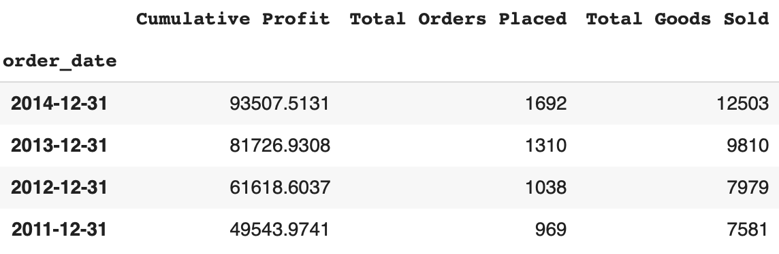
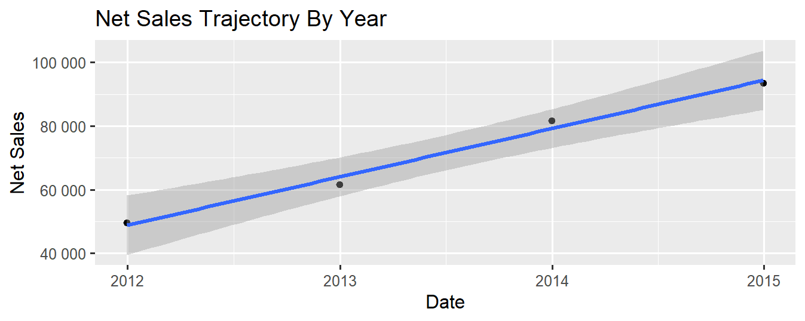
At a Glance: Year to Year
Profit Trajectory by Year
s
Cumulative Year to Year Bottom Line Analysis
Upon initial observation of SuperSupplier’s year to year trajectory, sales appear sturdy.
Profit, total orders placed, and total goods sold have each increased year to year.
Growth trend of profit is promising.
Notes:
Consider turning this (left chart) into plot (possibly 3d)

Slide 5
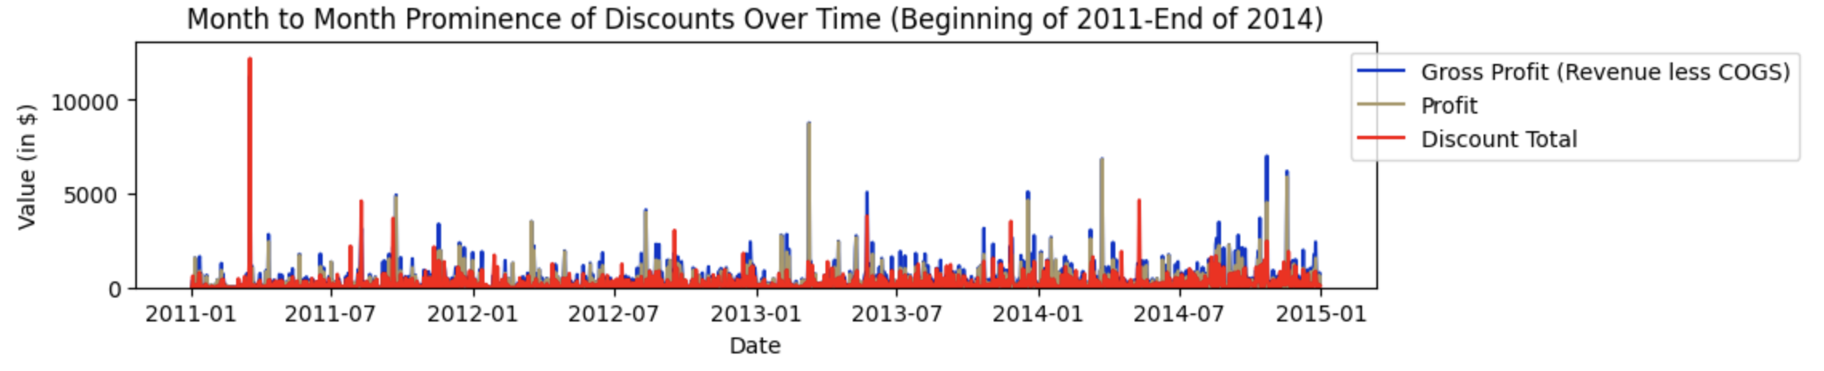
Prominence of Discounts in Sales
Business Issue for SuperSuppliers’
Profitable sales are currently being hard capped by an over issuance of discounts being applied to each customer order.

Slide 6
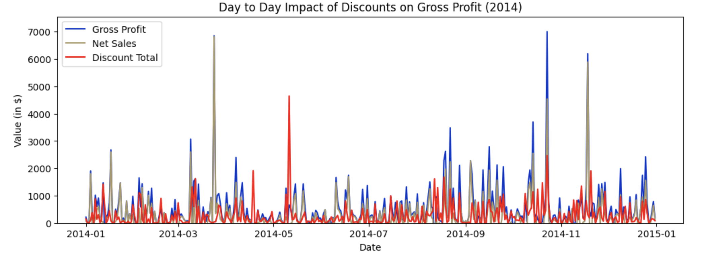
2014 Discount Visual
2014 Total Profit: $93,507
Total Monetary Value of Discounts in 2014: $101,398
Profit had discounts been more tightly controlled: $194,905

Slide 7
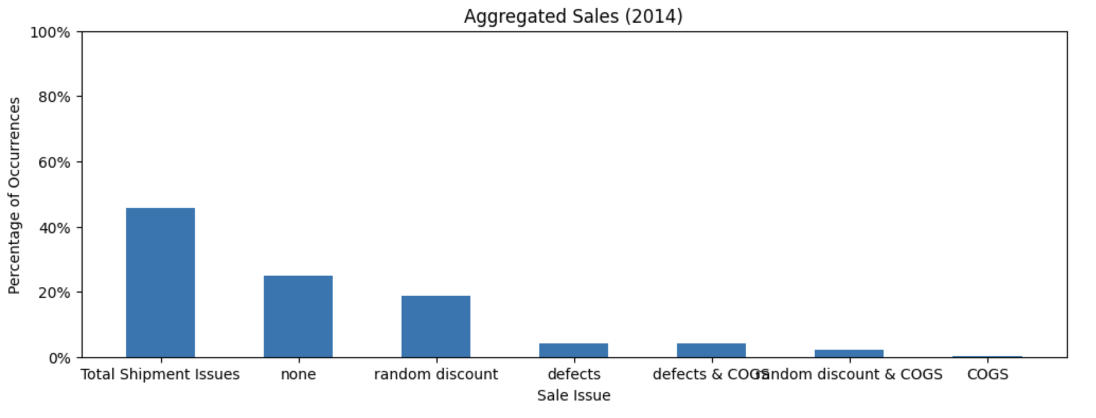
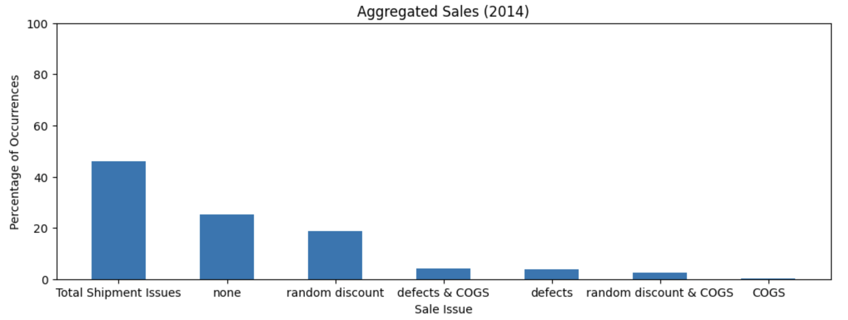
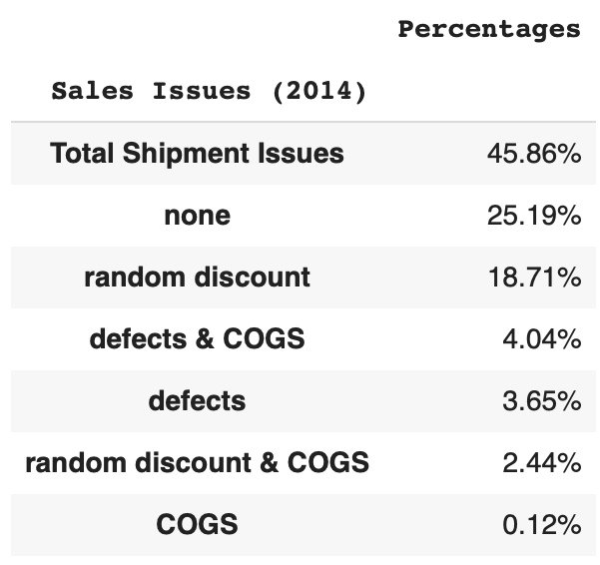
The Discounts and Sale Issues
Insight
In the most recent sales period (2014), our analytics team have pinpointed a number of ‘Sales Issues’ as the primary cause for this negation in sales.
‘Issues with Shipment’ define almost half of SS’ sales in 2014 and I believe this to be the primary issue to resolve going forward for SS to see an immediate spike in profit going into the next fiscal period.

Slide 8
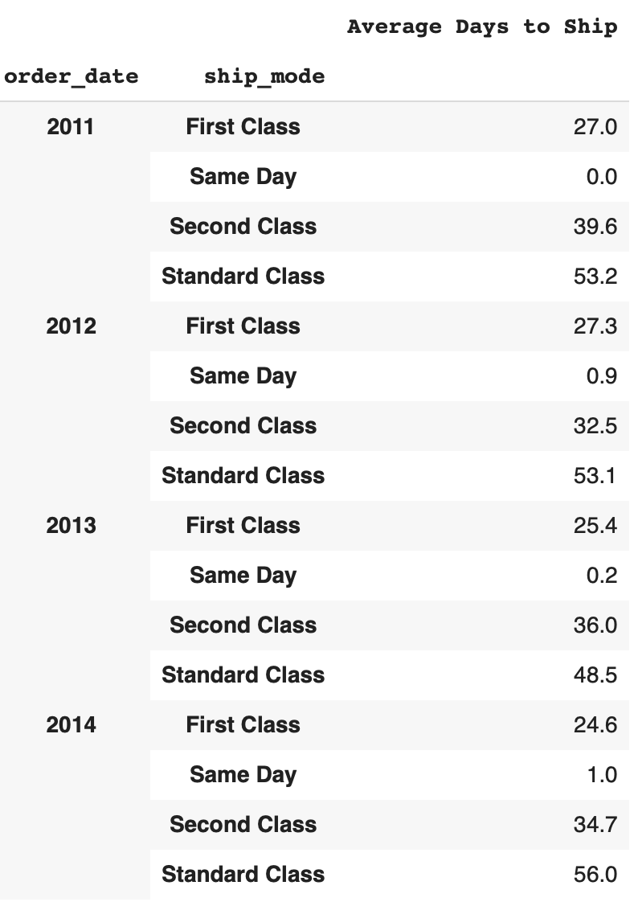
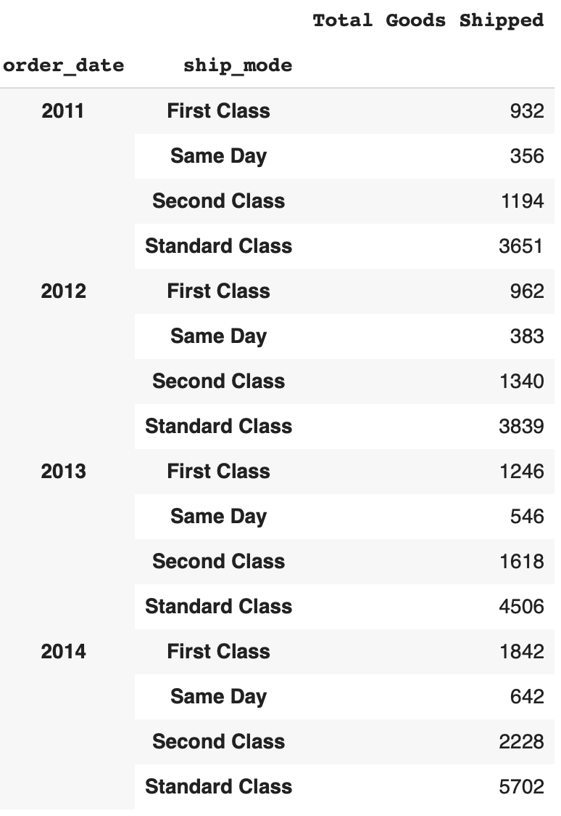
Standard vs Reality in Shipping
SS Shipping Standards
Standard Class: 6 Days
Second Class: 4 Days
First Class: 3 Days
Same Day: 0 Days
Prominent Issue:
Most customers purchase using Standard Class, they expect these goods to be shipped within 6 days, and yet, on average, their goods are being shipped close to 50 days after being ordered!
Customer retention is difficult, if not impossible, in the current state of business.

Slide 9
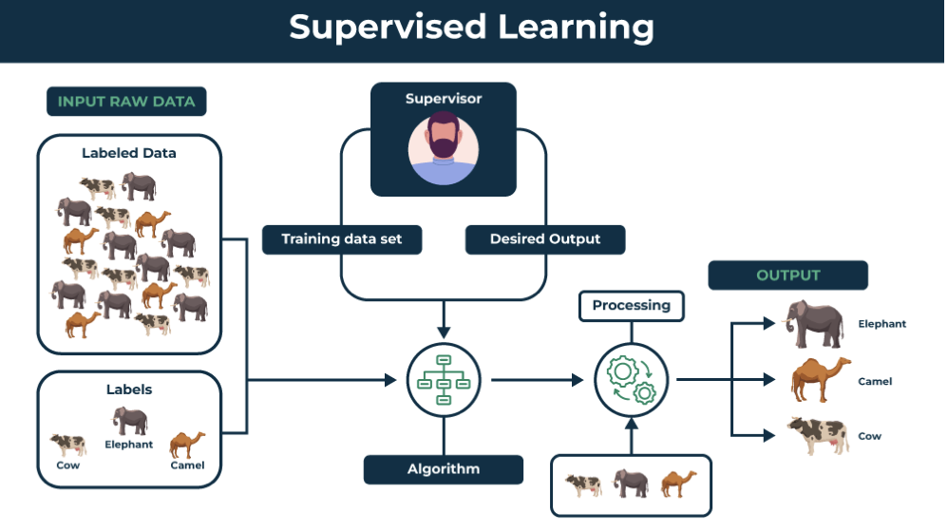
Solution: Classification Tree
GWU Business Consulting LLP
We have designed a Supervised Learning algorithm that is able to discern descriptive sales data attributes from each record of sale that is causing a Shipment Issue to arise.
Moreover, the model is able to reasonably predict whether a sale will cause such an issue to occur.

Slide 10
The Model: Holistic Description
Classification Tree to Predict Probability that a Sale will lead to a Shipment Issue
Objective: To predict whether a sales transaction will lead to an issue with shipment without being aided by key historical variables, found in the descriptive sales data, such as ‘Days (a past order took) to Ship’. Why? So model can be applied to incoming, future orders.
Data Used in Training & Testing: Each transaction that occurred from 2011-2014, as this provides the model with more data to learn from during training, to be able to make more accurate predictions on unseen (i.e. future) data.
Binary Classification: Each observation was labeled with either a 0 (No Shipment Issue) or a 1 (Shipment Issue) for training. These output values were hidden from the model during testing.
Limiting Complexity of Model & Preventing Overfitting:
Manual Dimensionality Reduction of variables likely to be recognized as noise (e.g., Order #)
Model Depth capped at 4. Minimum sample size to split at 25.
Current State of Model: Even lacking key data points that would strongly aid its predictive capabilities, (data that, for whatever reason, is not yet stored with the sales transactions e.g., manufacturing details, supplier info, quantity of product held in inventory, etc.), and needing to discern ‘Shipment Issues’ from a number of other sales issues, its predictive capabilities are still commendable -> roughly 63% predictive accuracy in classifying during testing.
Going forward, we recommend obtaining descriptive data from vendors and supply side distributors to enhance the models predictive capabilities. This model will then be able to confidently flag orders that are likely to cause ‘Shipping Issues’ as they are received by the processing system, ensuring SS can take the necessary precautions to prevent the issue.

Slide 11
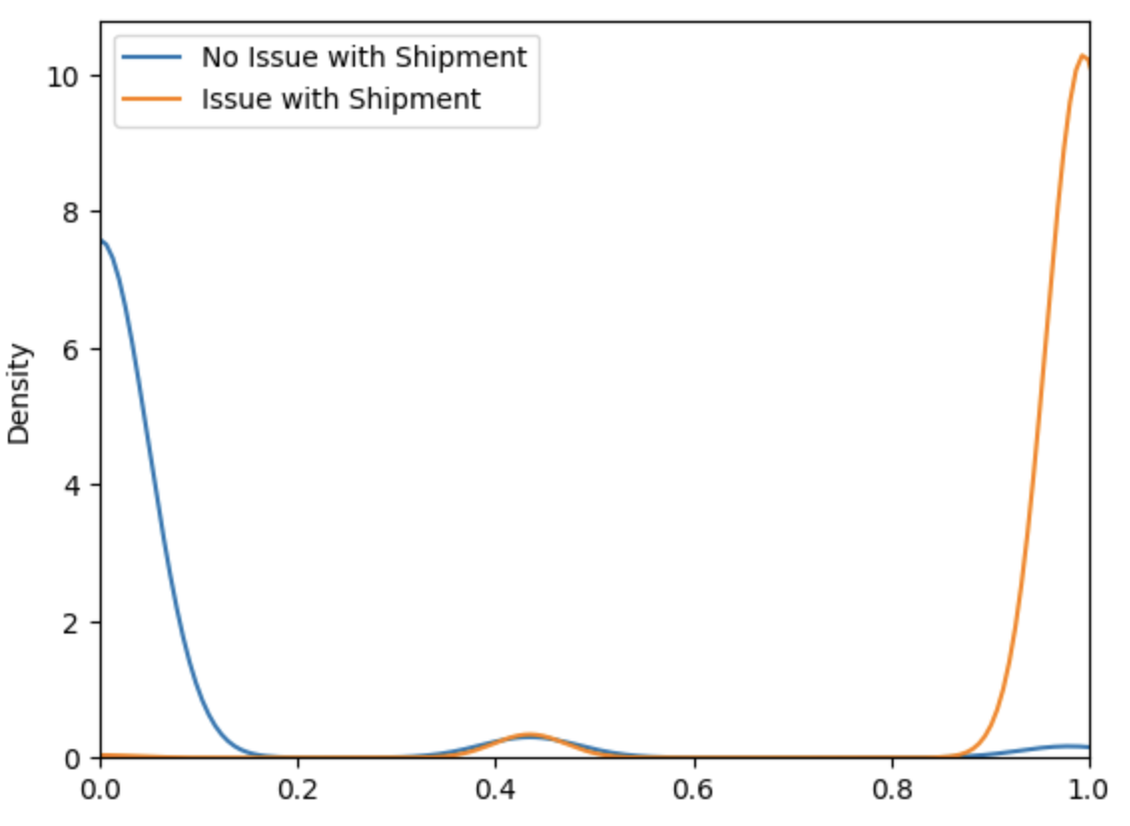
KDE Plot with Higher Quality Data
Visual Supports that Model is extremely confident in classification of data when given sufficient detail in shipment information
Minimum overlap (uncertainty) when classifying data during testing.
Model can confidently discern between a Shipment Issue and a Non-Shipment Issue with each transaction.

Slide 12
Business Value
Model can effortlessly be fine-tuned to analyze alternative avenues worth pursuing, with similar predictive efficiency.
For example, SS may not want model to split and classify using ‘Customer Name’ as a variable. A model with this variable removed was observed and its predictive qualities were practically identical to the presentation model (a few decimal points less accurate during testing). By simply removing this variable, model adjusted its splitting and classification methodology accordingly; moreover, the new model provided clear indication that specific zip codes and cities correlate with a higher frequency of issues with shipment.
Model is able to provide conclusive leads for SS management to pinpoint what is causing these shipment issues to arise and which common sales classes are causing these issues to occur most frequently.
Going forward, as more data is collected with each sales transaction and other sales issues are resolved, model will aid SS in identifying likely ‘Shipping Issues’ before they occur.
For Best Results
Obtain more supply side data from all suppliers and vendors of products being offered for immediate uptick in classification and predictive output of model.
Model can easily be retrained using these data points and will undoubtedly see greater predictive output from model.
Take initiative (detailed in Appendix) to resolve the other issues occurring in sales.
Closely monitor all transactions, in the next sales period, that have sales characteristics inline with those correctly classified by (current) model as having ‘Shipment Issues’, as soon as order is placed.

Slide 13

Business Outcome
Reinstate trust within customer base.
Retaining a larger portion of customers.
Customers feel that their business is valued.
Higher ratio of Customer Retention = More profitable day-to-day business operations
Most frequently occurring issue causing loss in profit to occur will be understood and resolved.
BOTTOM LINE
Less shipment issues -> more loyal customers -> less discounts necessary to keep customers returning -> higher profits.

Slide 14
GWU Business Consulting LLP we hope that these insights & recommendations prove valuable!
Any questions? Feel free to reach out!
If needed, attached is a link to a copy of your data of initial data:
Superstore Dataset (kaggle.com)

Slide 15
Table of Contents: Core Appendix
Additional Analysis
General
Product
Client
Additional Sale Issues & Outcomes

Slide 16
1.1 Additional Analysis & Business Recommendations: General

Slide 17
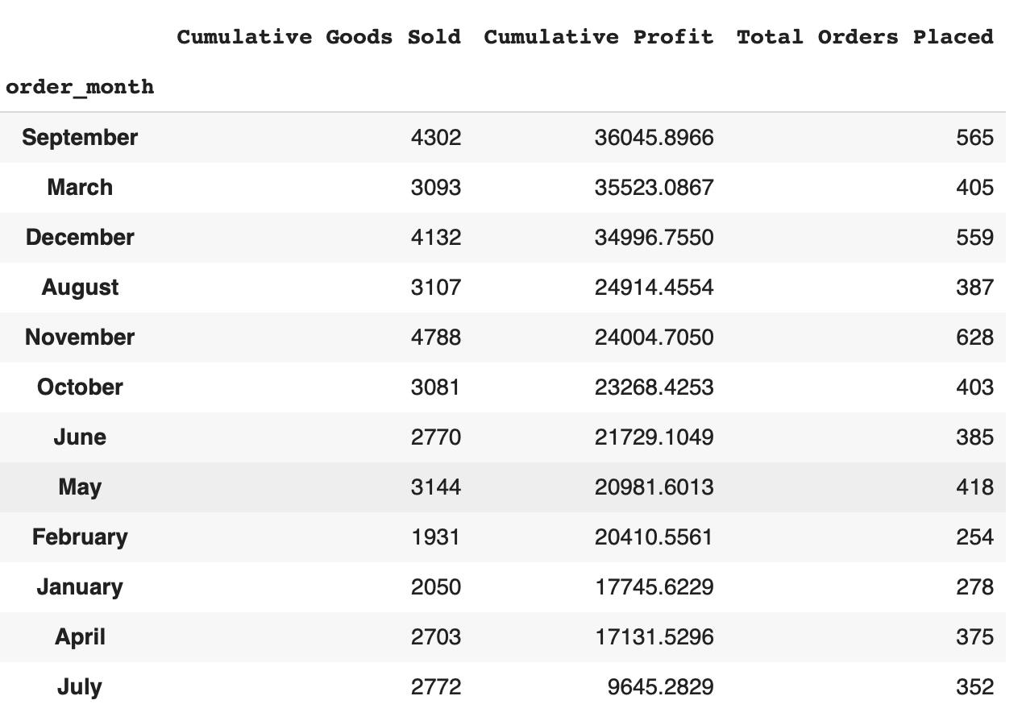
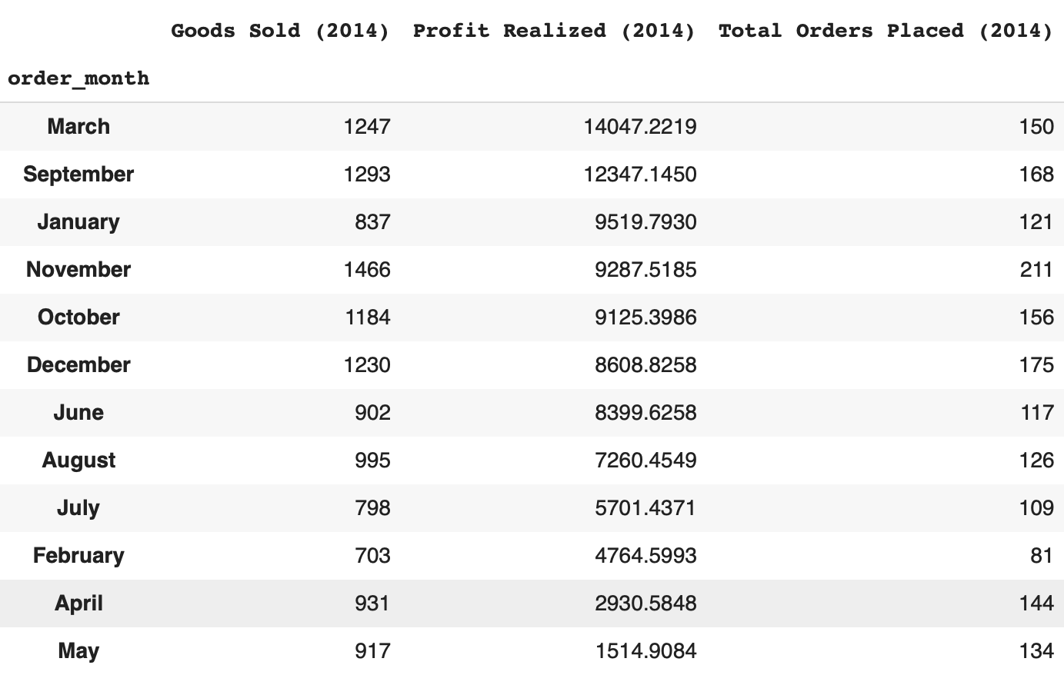
Month to Month
General Month to Month Trends (Cumulative vs 2014)
March and September appear to be sales periods when SuperSupplier’s should expect to receive the largest volume of sales.
Notes:
Consider making 3d plots

Slide 18
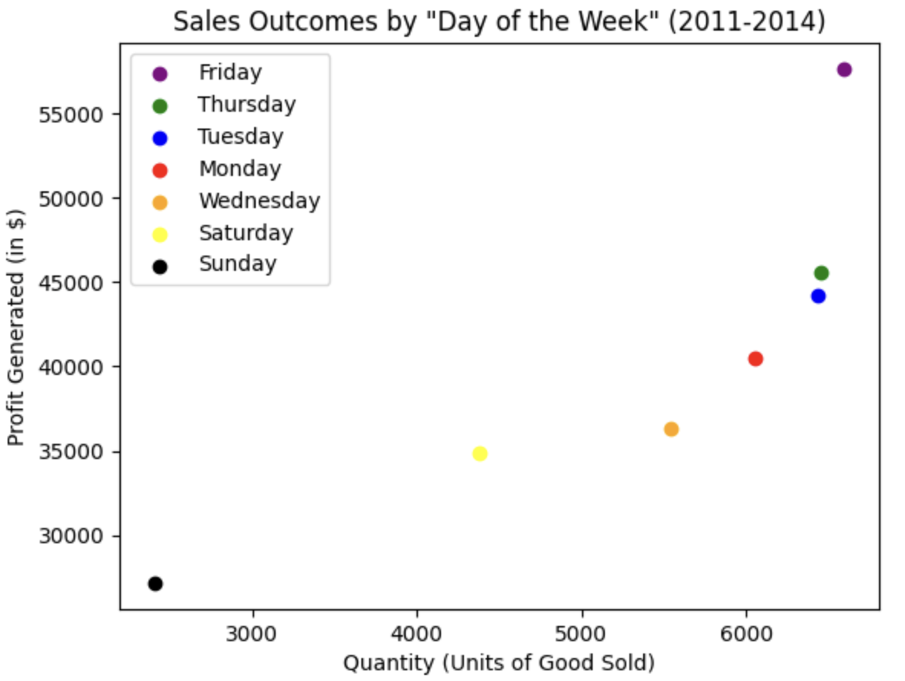
Day of Week
Day of Week Trends
Aggregated sales qualities, as per day of week (2011-2014) reveals a positive correlation with profit and quantity of goods ordered.
SS can expect to receive highest volume of sales towards the end and beginning of the business week.
Notes:
Consider making a 3 dimensional plot

Slide 19
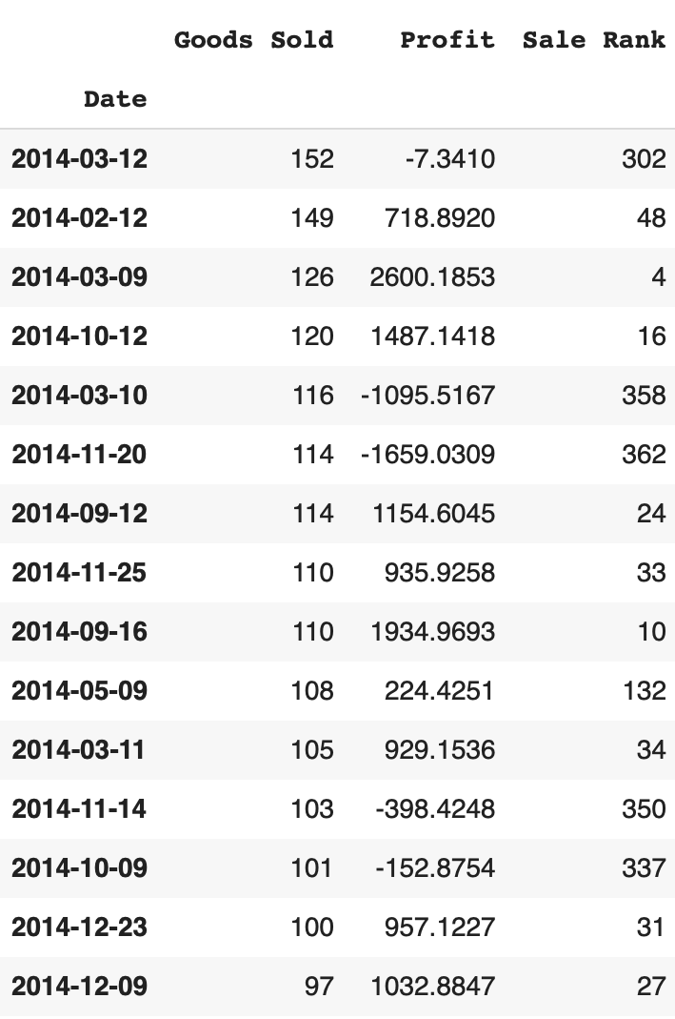
Goods Sold vs Net Sales (2014)
Digging Deeper into Sales in 2014
The chart to the right explicitly illustrates the large variation in number of goods sold and profit outcome, by day.
Clearly see that, until discounts are removed from being a prominent part of SS’ business model, a positive relationship between Net Sales and (Volume) of Goods Sold will not be achievable.
Valuable Insight
It is very likely that the prior VP in sales gradually realized that customers purchasing in volume often generated higher net sales; therefore, began distributing discounts to increase the likelihood that customers will add more to their carts.
We clearly see that, unfortunately, the opposite effect occurred, more often than not.

Slide 20
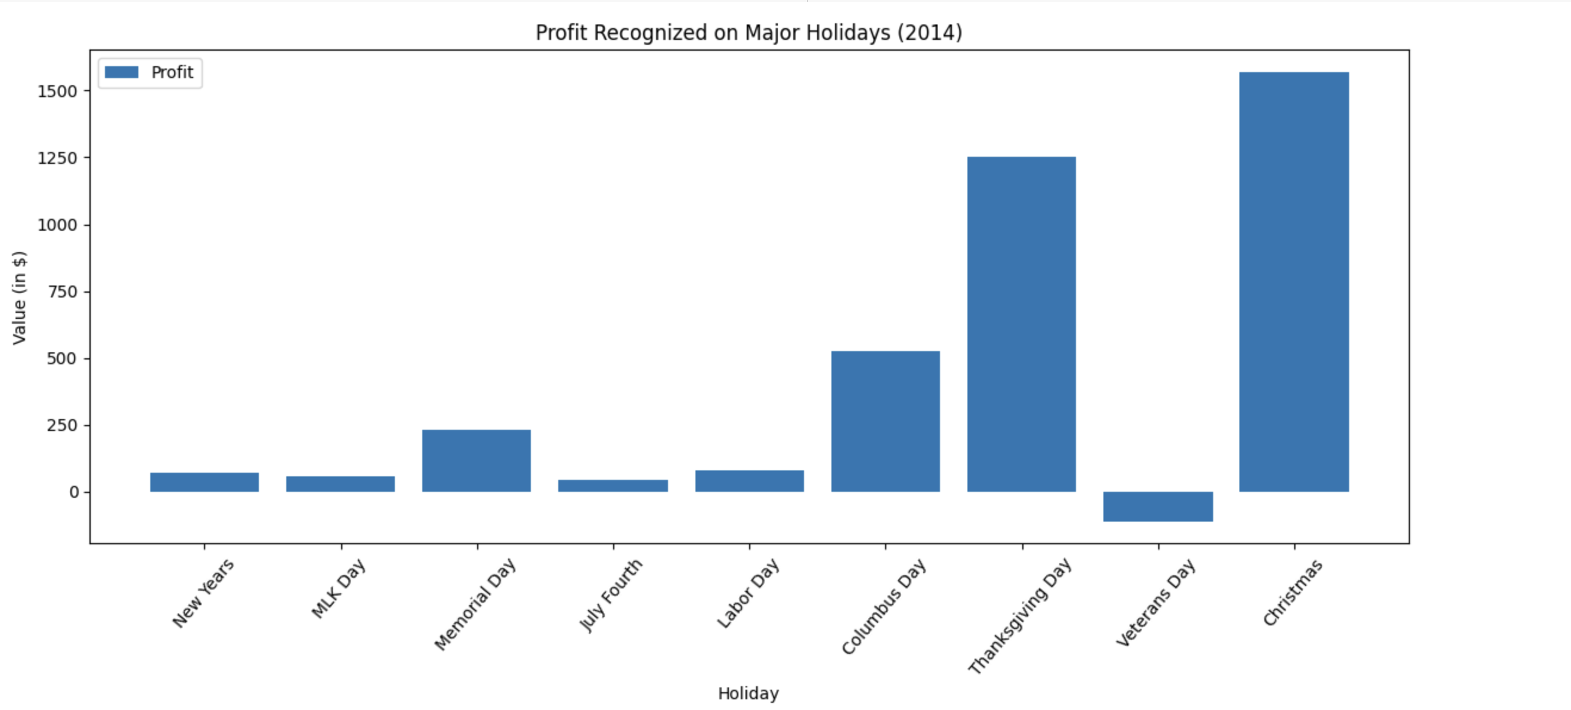
Holiday Sales (2014)
Current Analysis
It is clear that Christmas Day and Thanksgiving Day are two of SS’s most profitable sales days; however, the major insight to be gained from this observation pertains to sales frequency and strange deviations from the norm.
Columbus Day: Customers purchased 78 items on this date and yet SS only generated $526 in profit for SS. Roughly $700 less than Thanksgiving (in which 69 goods were sold) and over $1000 less in profit than on Christmas (in which only 54 goods were sold).
Veterans Day: 64 goods were bough by SS clientele on this date and yet, this resulted in a $111 decrease in profit.
NOTE: The reasons for these deviations is due to discounts.

Slide 21
1.2 Additional Analysis & Business Recommendations: Product

Slide 22
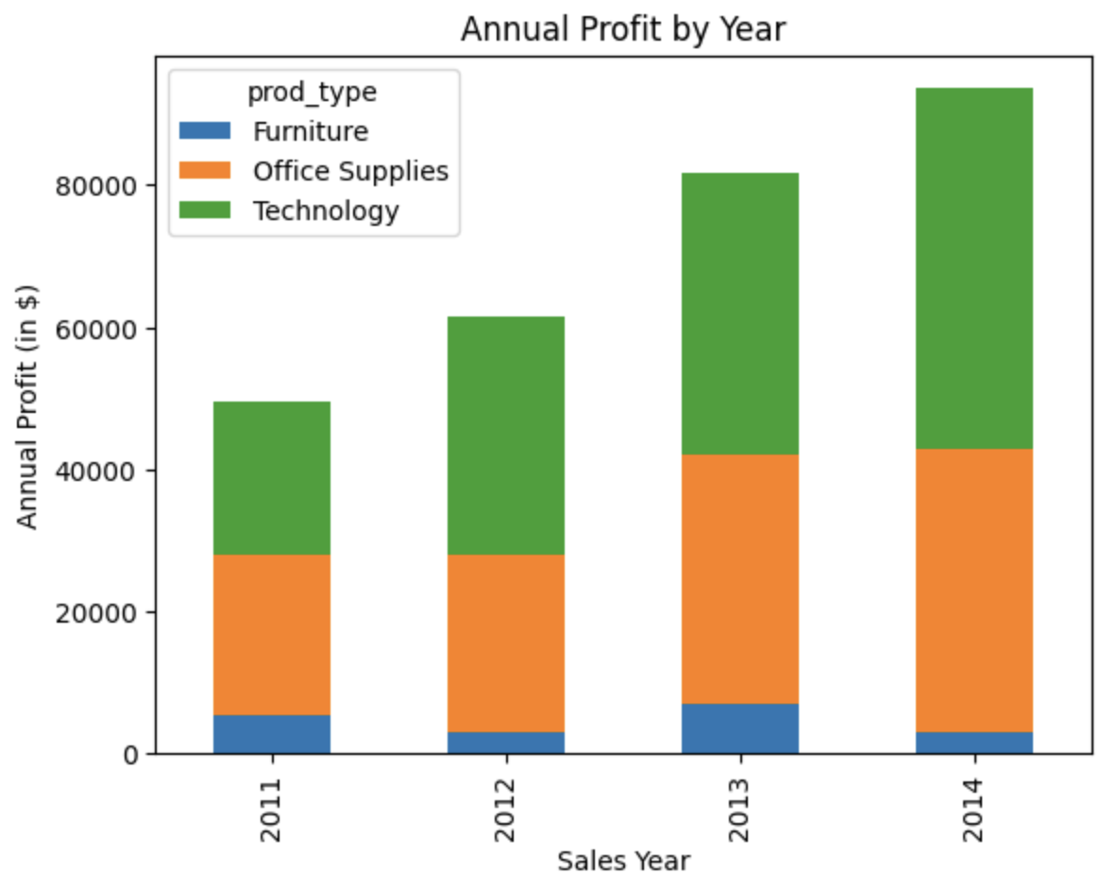
Profit and Product Base
Cumulative (2011-2014) by Product Type
Technology: $145,454 in profit
Total Goods Sold: 6,939
Discounts Applied: 1,014
Average Price of Good: $132
Average Cost to Sell: $94
Office Supplies: $122,490 in profit
Total Goods Sold: 22,906
Discounts Applied: 2,897
Average Price of Good: $34
Average Cost to Sell: $25
Furniture: $18,451 in profit
Total Goods Sold: 8,028
Discounts Applied: 1,285
Average Price of Good: $102
Average Cost to Sell: $85

Slide 23
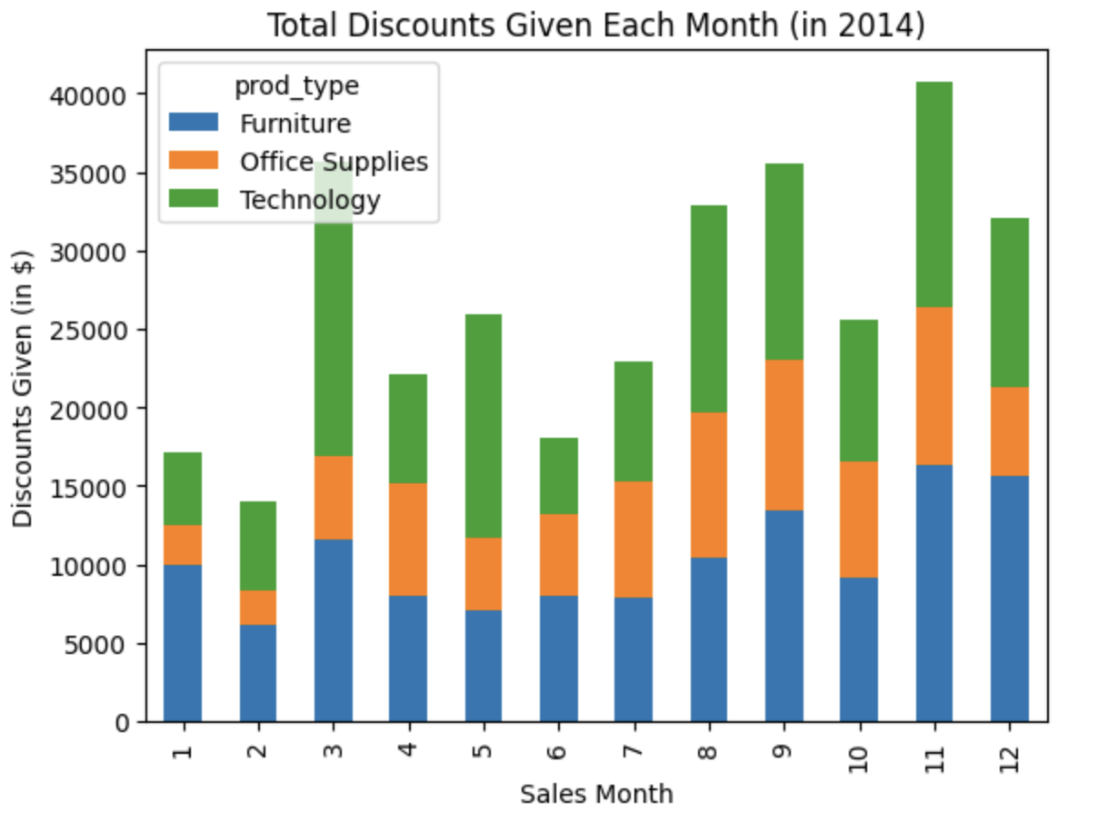
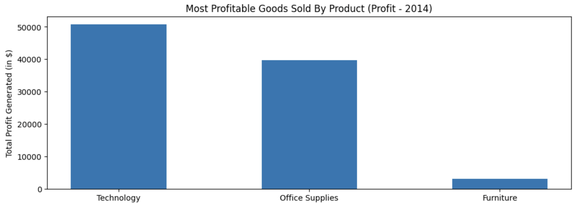
Profit vs Discounts on Products (2014)
Technology
Sold: 2,366
Discounts Applied: 342
Average Price: $131
Average Cost to Sell: $82
Office Supplies
Sold: 7,700
Discounts Applied: 974
Average Price: $34
Average Cost to Sell: $25
Furniture
Sold: 2,437
Discounts Applied: 412
Average Price: $97
Average Cost to Sell: $81

Slide 24
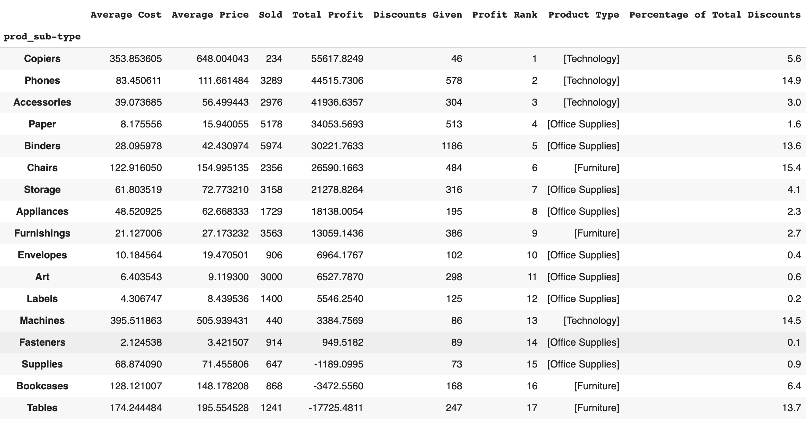
Overview of Product Sub-Types
Cumulative Product Sub-Type Chart
An insightful chart illustration that outlines how each product sub-type has performed over the years.
Phones: Although it is the product that contributes to 14.9% of SS’s total discounts (in terms of total $ lost) it still cumulatively generates the second most profit.
Tables, Bookcases, & General Supplies: Three products that seem to be a trouble area in terms of sales.
Tables: Have lost over $17K in profit for SS since 2011!
Supplies: Average selling price of these goods is only $3 more than the cost to supply them.
Most products within these sub-types should be removed from inventory.

Slide 25
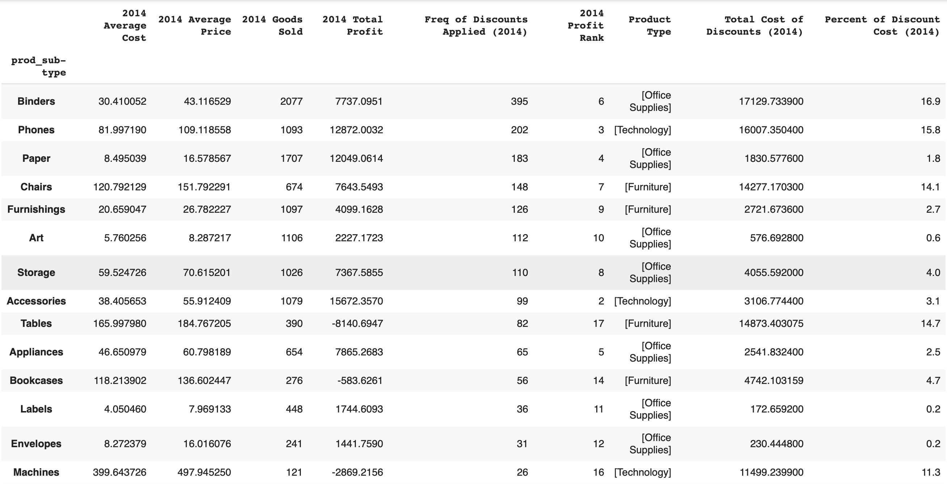
Product Sub-Types (2014)
Ranked by Frequency of Discounts
This chart provides a deeper analysis as to how each product sub type has been performing recently.
Copiers: Not only is this SS’s most profitable type of product to sell, but it causes the least amount of issues with discounts in terms of frequency of occurrences.
Copiers should be more heavily advertised to customers.
Binders: Most amount of discounts applied to these product types by a good amount and product that is responsible for 16.9% of the total discount value in 2014.
If impossible to avoid applying discounts, remove.

Slide 26
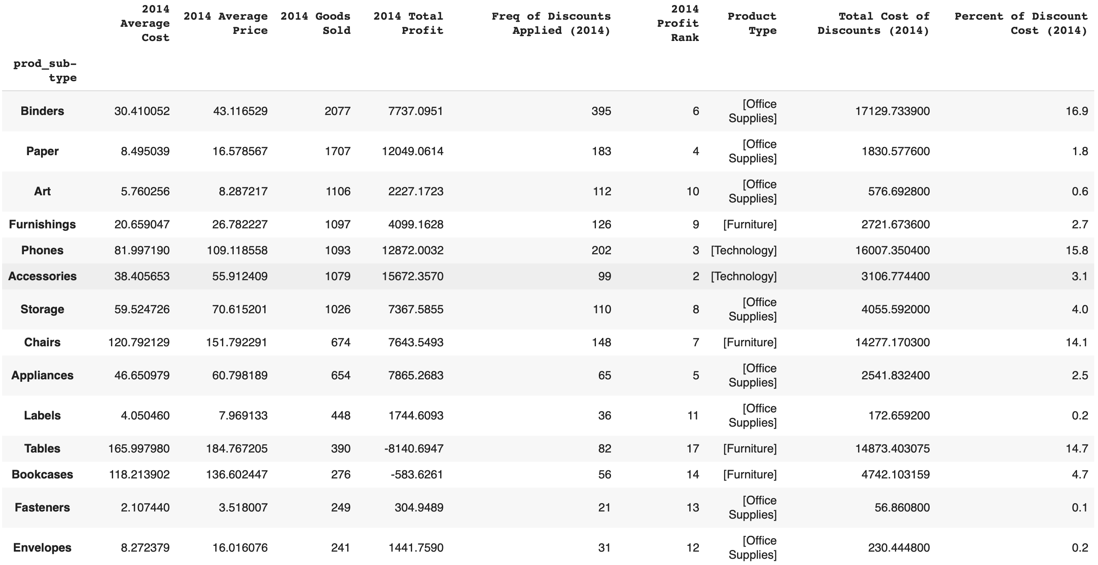
Product Sub-Types (2014)
Ranked by Number of Items Sold
This chart illustrates which products are most popular, in terms of sales frequency, in 2014.
Copiers: Unfortunately, Copiers is SS’s least popular product in terms of times sold! The marketing team for SS certainly needs to prioritize making more sales of these products, whilst steering clear of applying discounts to do so.
(General) Supplies: Clearly a product that should be strongly considered for discontinuation. It isn’t popular and has led to an almost $1,000 decrease in net sales in 2014!

Slide 27
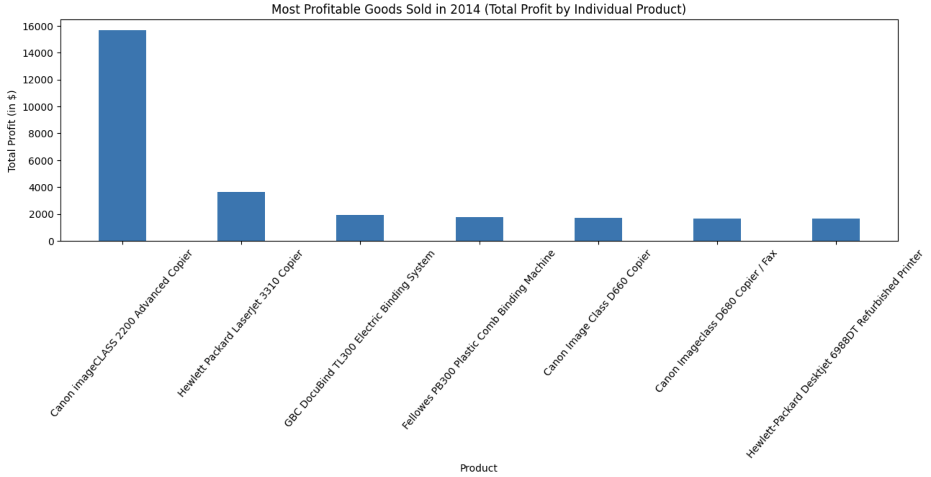
Individual Product Analysis (2014)
Goods that generated the most profit in 2014 (Aggregated Total Net Sales)
Canon Copier: Only 11 of these products have been sold in 2014 and yet is still has generated a grand total of almost $16K in profit.
The GBC DocuBind & the Plastic Comb Binding Machine: It is somewhat surprising to see that these products of the “Binder and Office Suppliers” class fall within the top 7 profit generating products. These two products could generate an even larger spike in profit if not for the fact that they, on average, are typically sold with 32% and 15% discounts applied to them, even though they tend to ship within only 5 days.

Slide 28
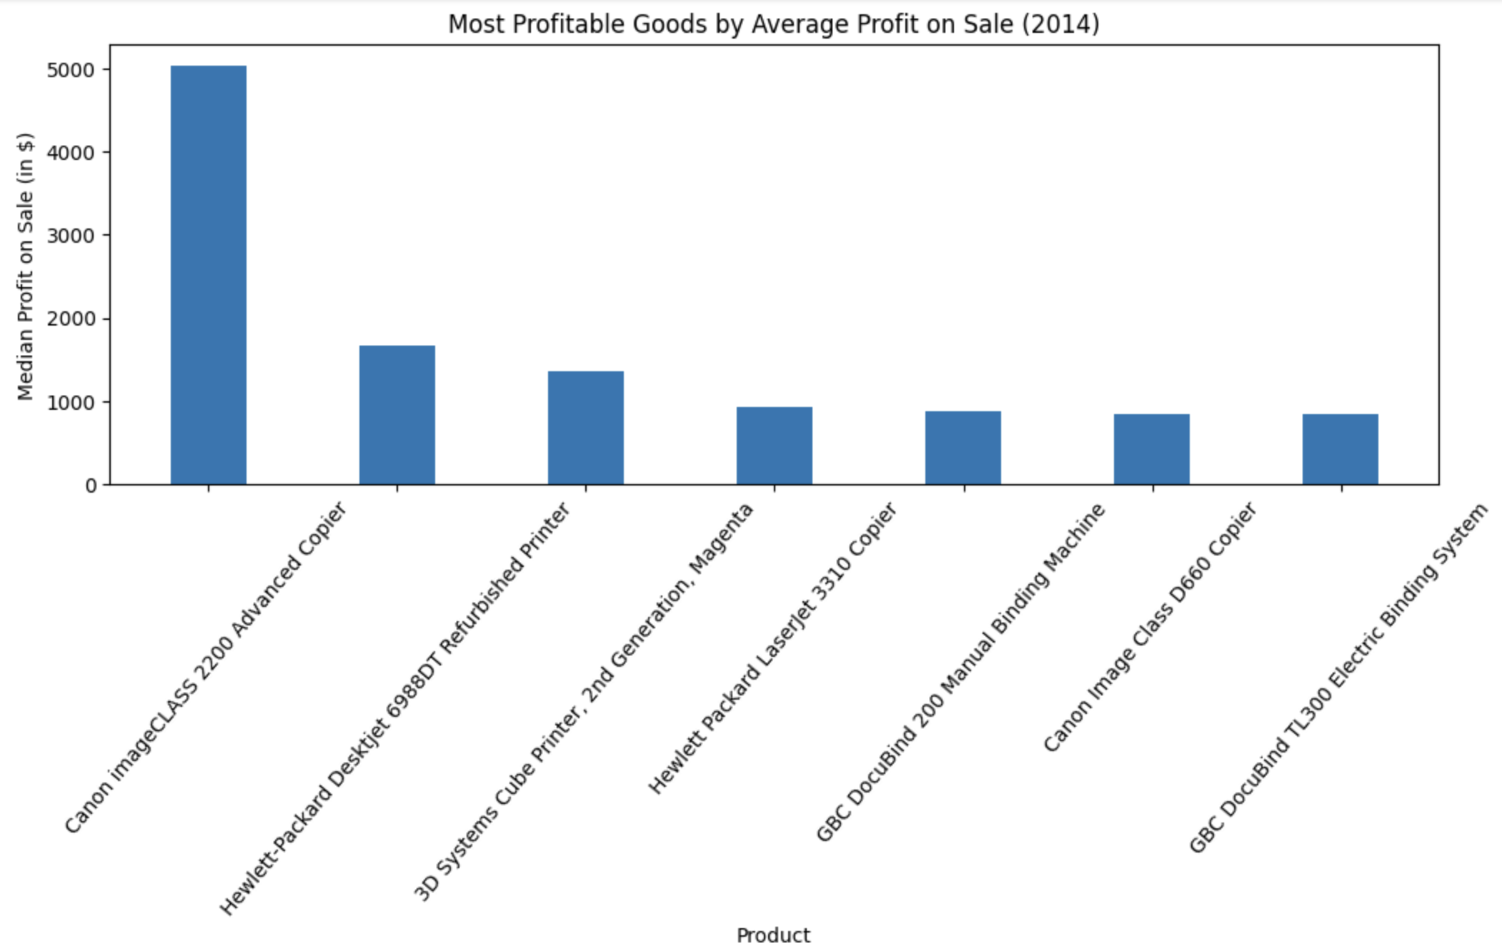
Individual Product Analysis (2014)
Goods that generated the most profit in 2014 (Aggregated Median Net Sales)
Canon Copier: Per order, on average, this product generates a little over $5K in profit!

Slide 29
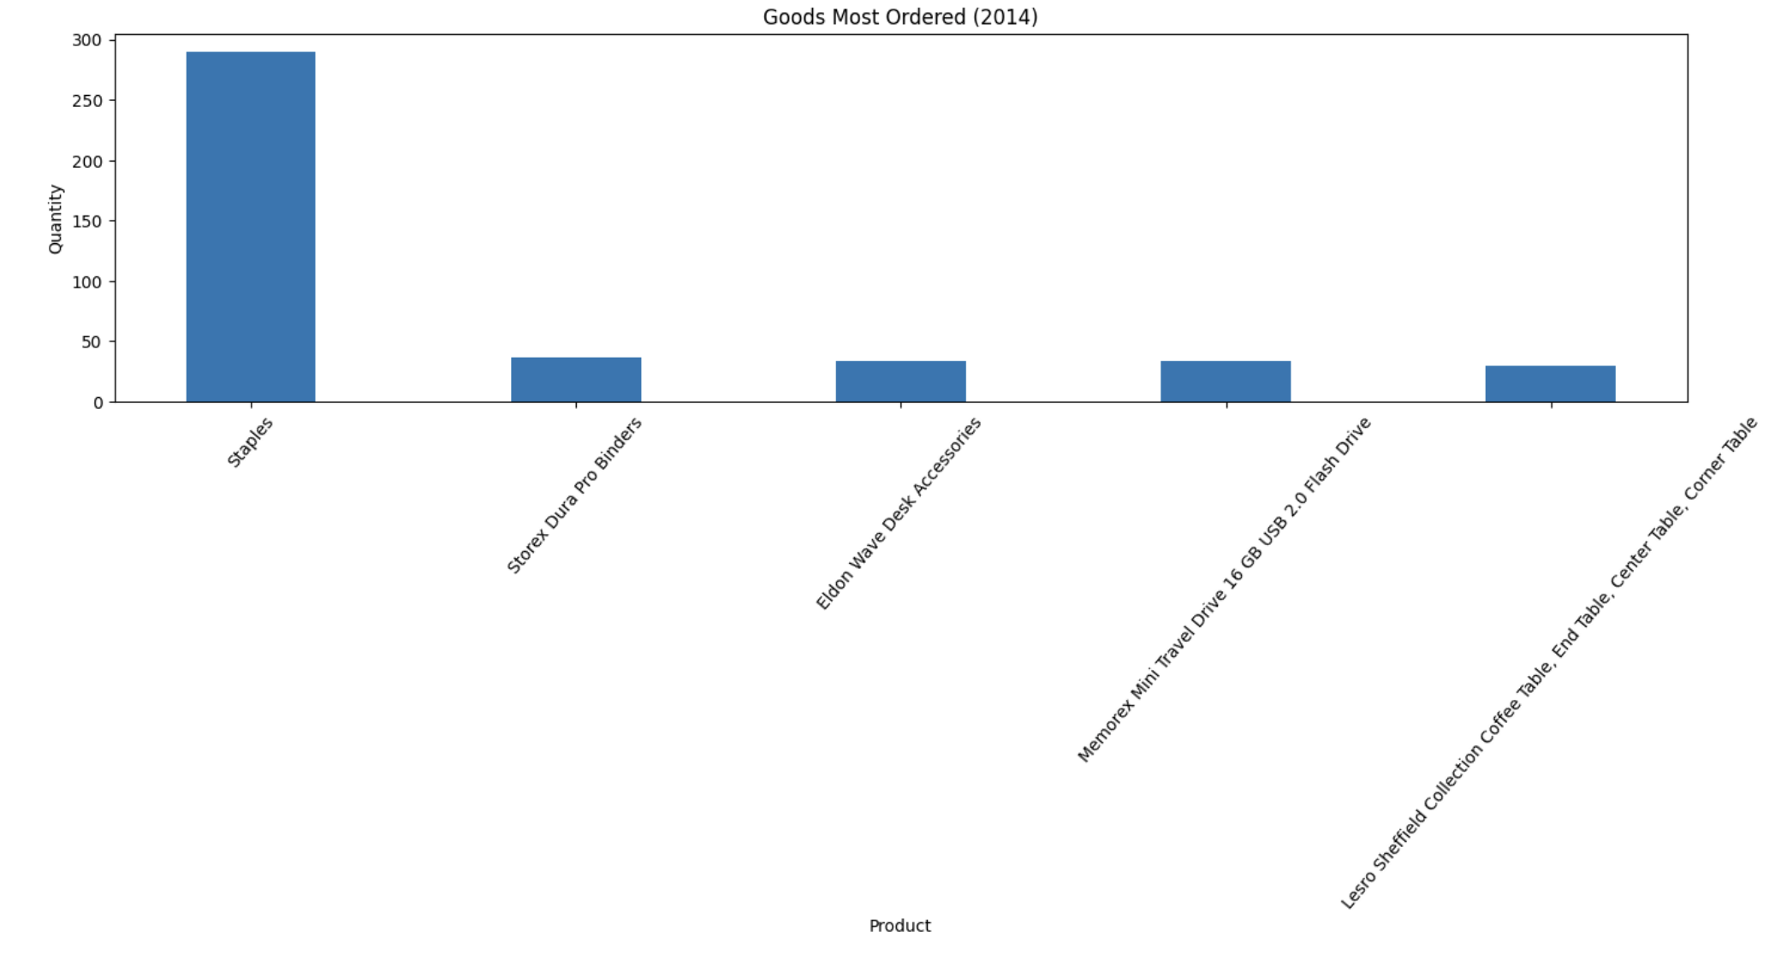
Individual Product Analysis (2014)
Most Ordered Goods in 2014
Noteworthy Background Detail on Some of Above Products
Staples: This product has been sold 290 times; however, 31 of those occurrences have had discounts applied to them.
Storex Dura Pro Binder: On (mean) average, this product costs $3.08 to sell with a selling price of only $3.59 (on average). Moreover, the median time delay in shipping is 40 days for this product and averages an applied 50% discount per order. For these reasons, it is clear why this frequently purchased product has only generated a total of $23.58 in sales in 2014, with a mean net sale of negative $2.

Slide 30
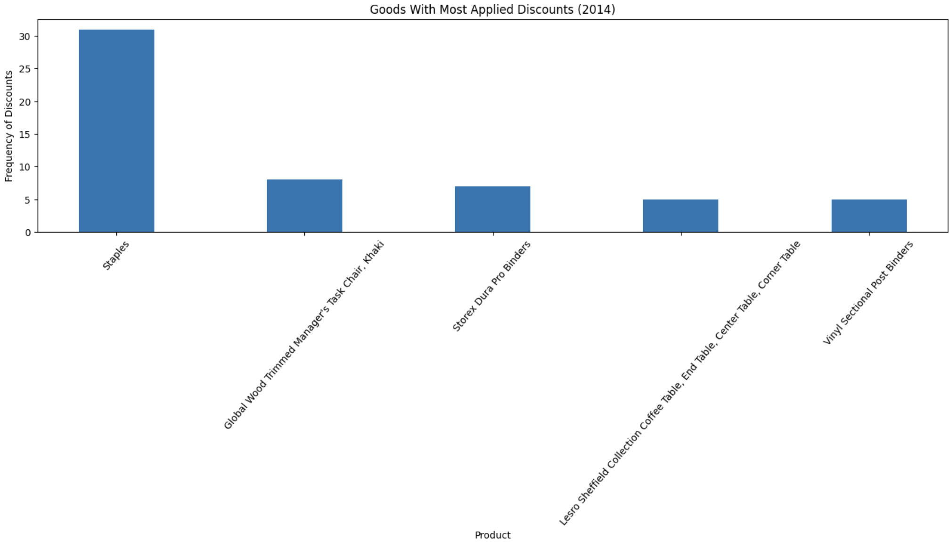
Individual Product Analysis (2014)
Products That Correlate with Highest Frequency of Discounts
Noteworthy Background Detail on Some of Above Products
Global Wood Trimmed Task Chair: On average, this product faces a $75 cost to sell with an average selling price of $81.42. Those are terrible margins for a product that should be PROFITABLE. Moreover, on average, this product takes 33 days to ship and has had 8 discounts applied to the only 27 sold chairs of this type. With each discount average 25%, this has all culminated in the product underperforming and generating a loss of $272 for SS in 2014.

Slide 31
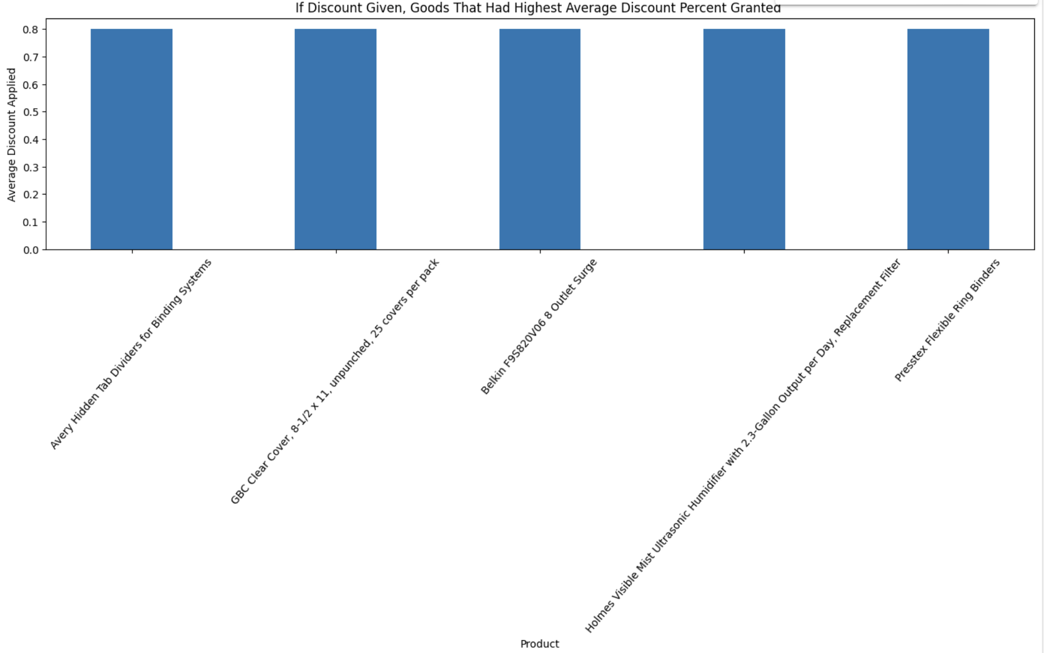
Individual Product Analysis (2014)
Goods With Highest, On Average, Applied Discount Percentage
On average, each of these products being sold causes the sale to be negated with an 80% discount. Moreover, and perhaps unsurprisingly, each of these products (all of which are from the “Office Supplies” Product Base) have generated losses for SS in 2014.

Slide 32
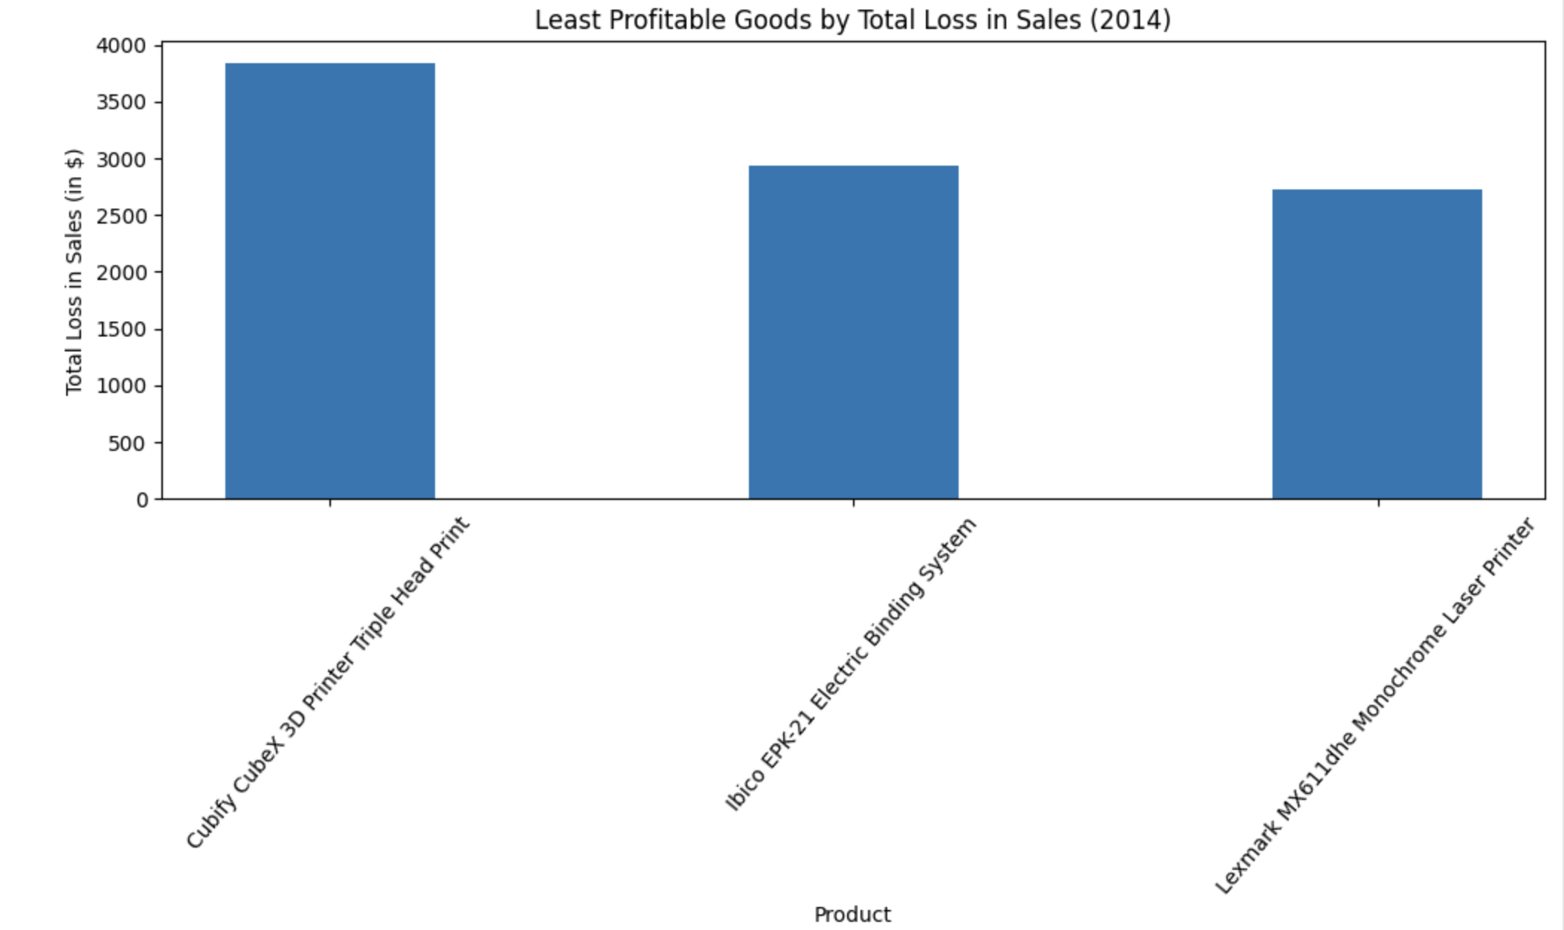
Individual Product Analysis (2014)
Least Profitable Goods 2014
Each of these products totaled a loss of $2,000 in net sales each and each had a discount applied to their orders of more than 40% on average. The correlation of high discounts and loss in sales is clear.

Slide 33
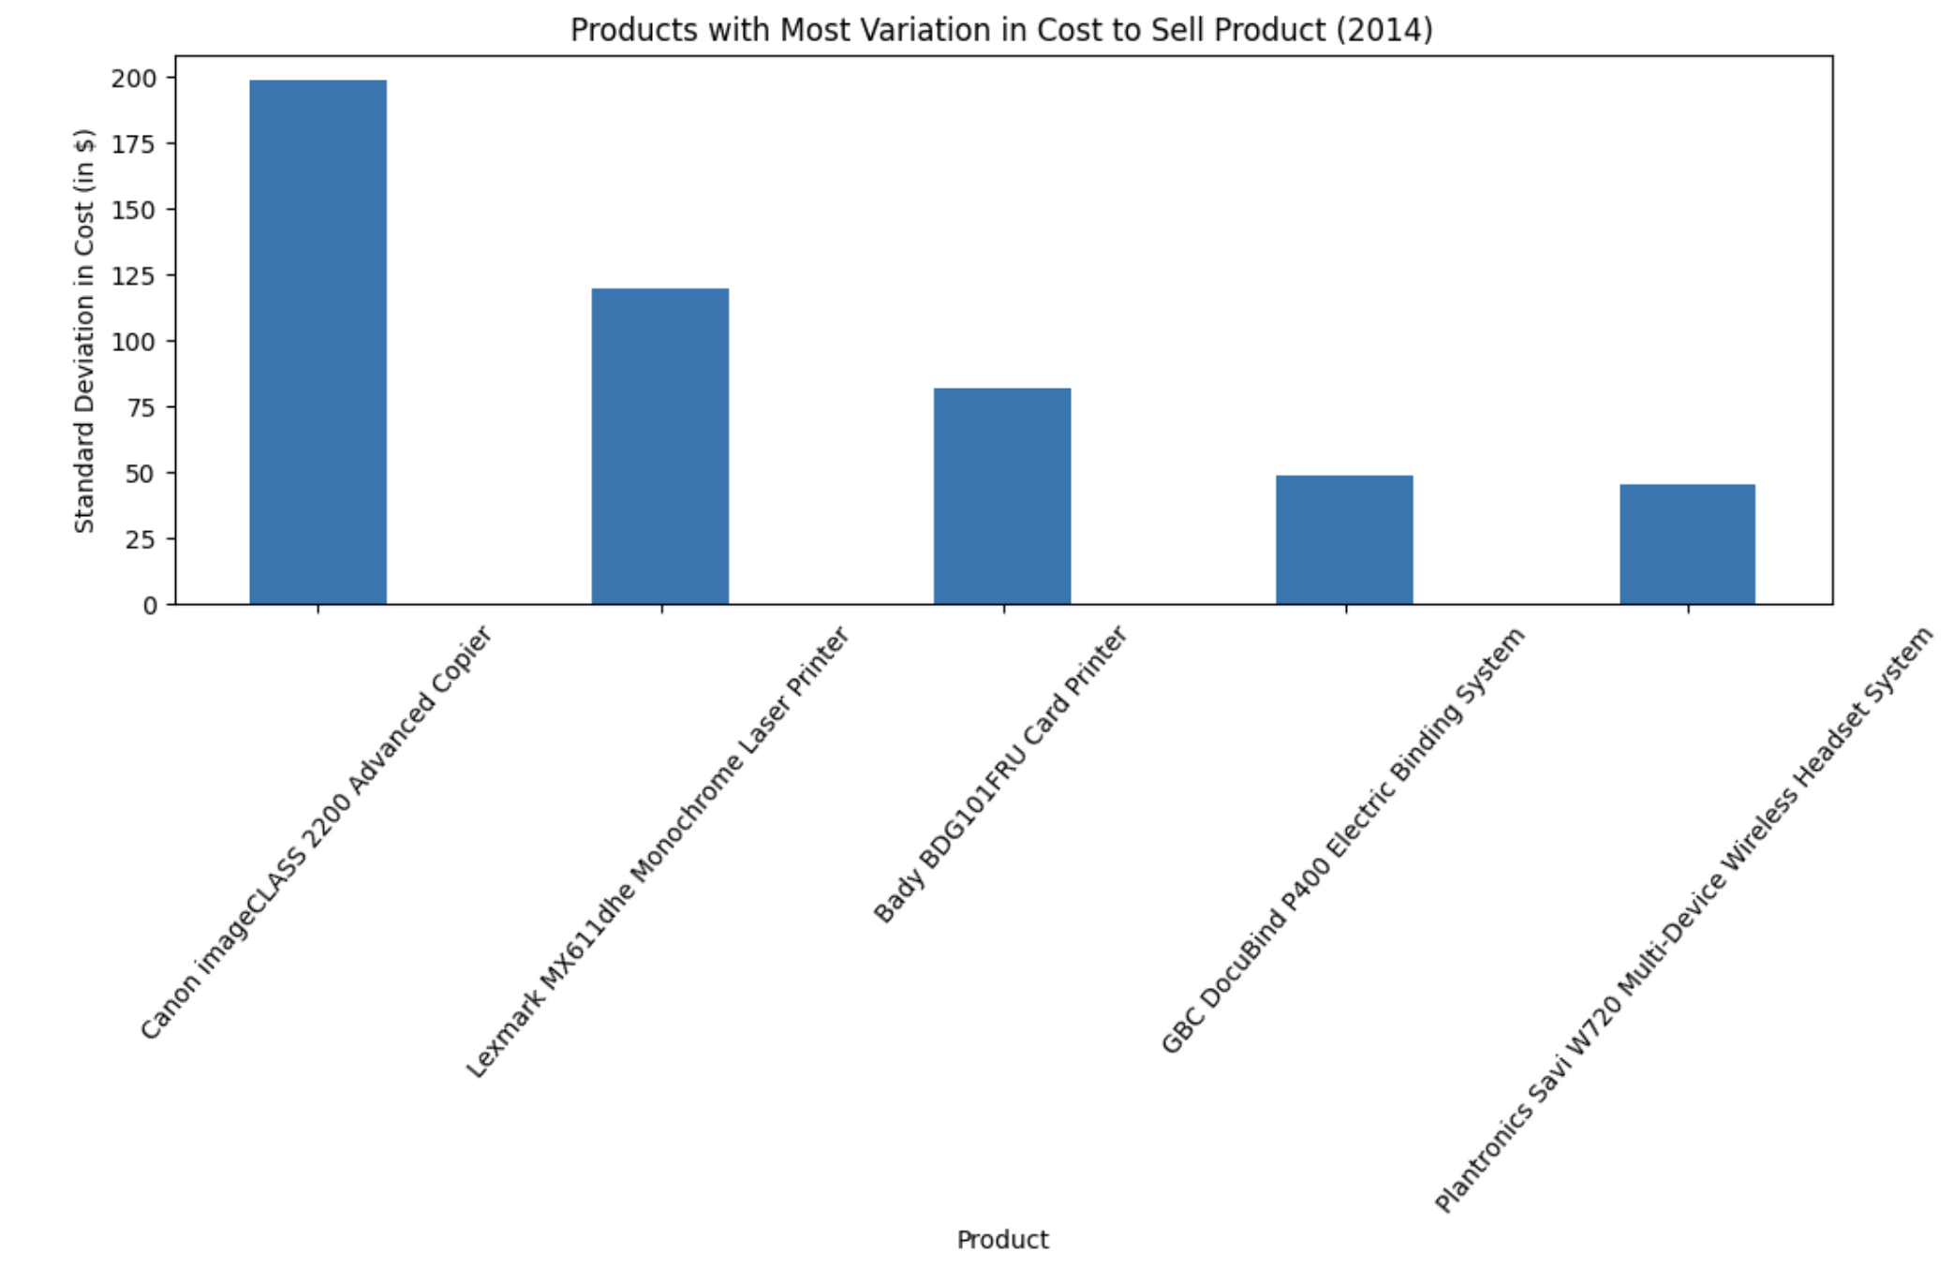
Individual Product Analysis (2014)
Goods Sold in 2014 with Largest Standard Deviations in Cost
For SS to realize more consistency in sales, the root cause of what is causing these large deviations in cost for SS to sell these products must be discussed and resolved. Over a span of three years, even accounting for inflation, there is no reason for these large deviations in cost to occur.

Slide 34
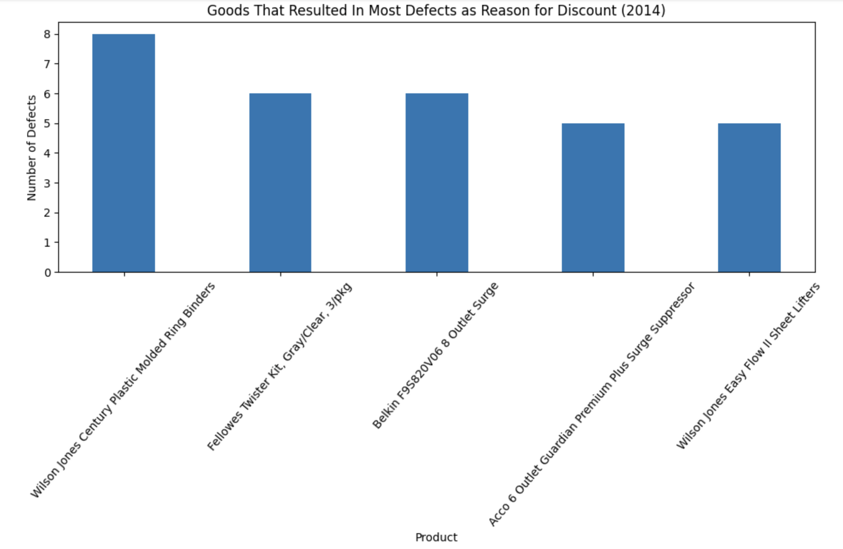
Individual Product Analysis (2014)
Goods that Resulted in Most Defects in 2014
Background detailing of this analysis: After closely inspecting each sale, I was able to very closely estimate how many goods were defected in each order (in other words, the customer was likely unhappy with the order), by analyzing how long the good took to deliver and what the discount value was in accordance with the full-retail selling price of the good. Although this was not explicitly detailed in the data, it is fair estimation of the total frequency of occurrence that a customer ordered these products and were discontent with these sale.
In other words, say for example, a product was purchased, and a discount was applied with no delay in shipment or any other valid reason for a discount to be applied, and the price of the product before being discounted was $1, with the given discount being less than or equal to the selling price, I recognized the likely reason for the discount being ‘customer unsatisfaction’, due to the quality of the product. Hence, the ‘defect’.

Slide 35
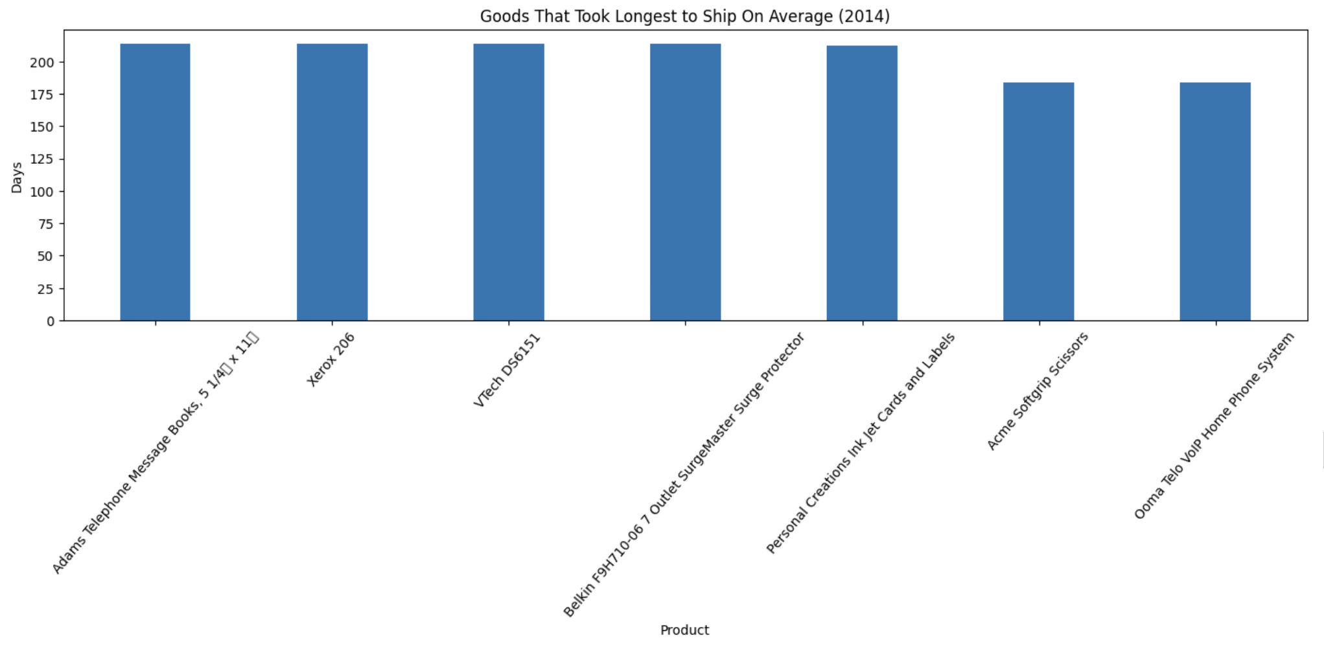
Individual Product Analysis (2014)
Goods sold in 2014 that, on average, presented the largest delays in shipment.
Urgent that these products are closely scrutinized.
If shipping delays can’t be improved for these products, they must be removed from inventory.

Slide 36
1.3 Additional Analysis: Client

Slide 37
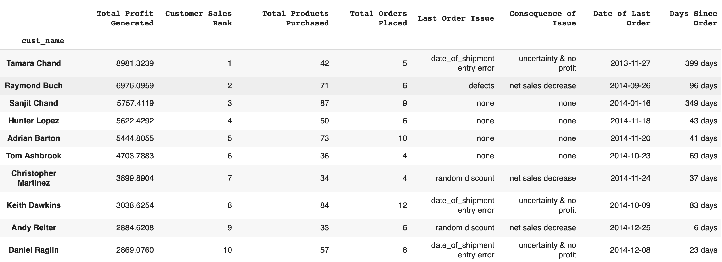
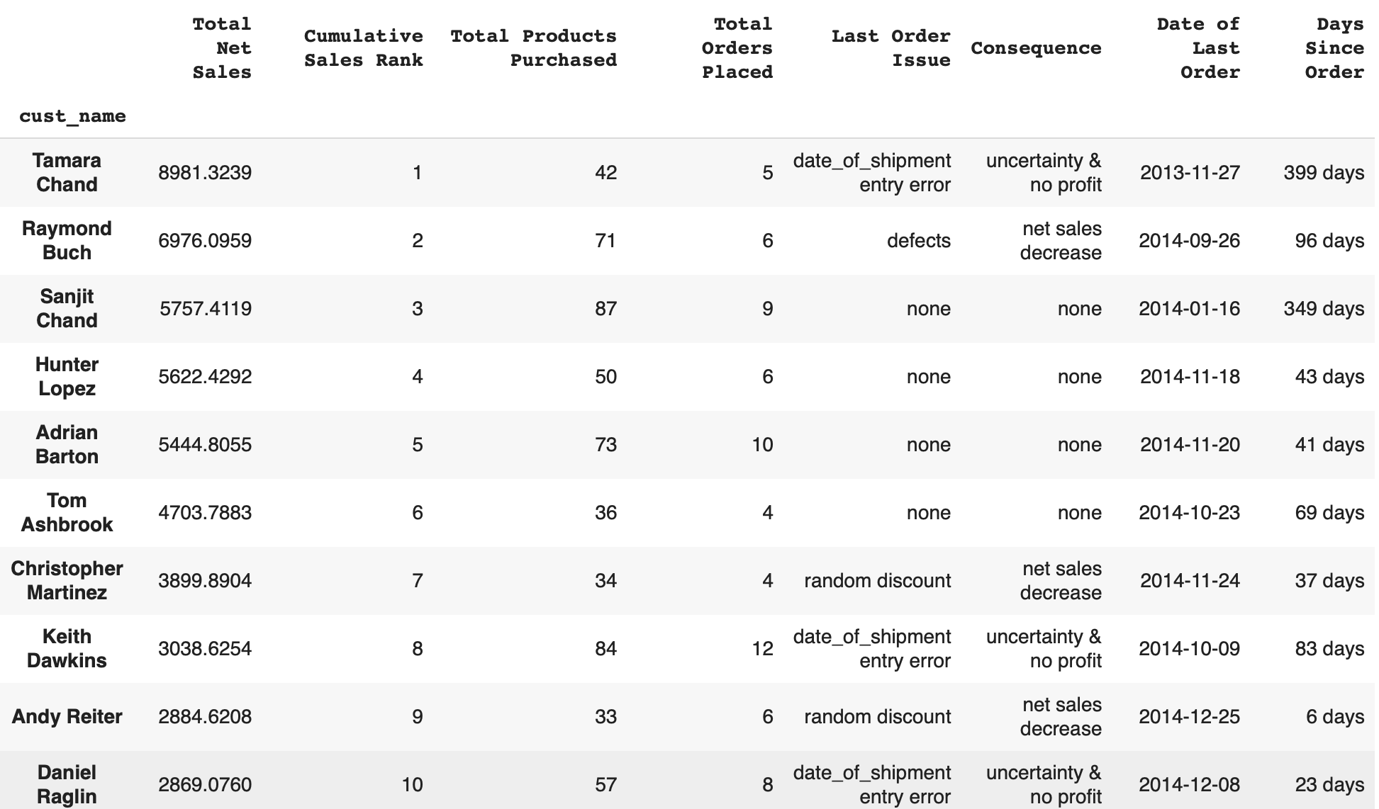
Most Profitable Clients (2011-2014)
Most Profitable Customers (Total Net Sales Generated)
Again, trying to differentiate customers currently based on “Total Net Sales” is not advised and does not paint a clear picture of the objectives to be realized by SS to reduce variation in sales on a maintainable basis.
For example, Tamara Chand is noted as being the #1 most profitable customer in terms of total net sales, yet $8400 of those $8981 recognized were due to one order. However, Perhaps most importantly, that was one of her last placed orders and she ordered using Standard Shipping, her orders were shipped 214 days after being placed and yet no discount was administered.

Slide 38
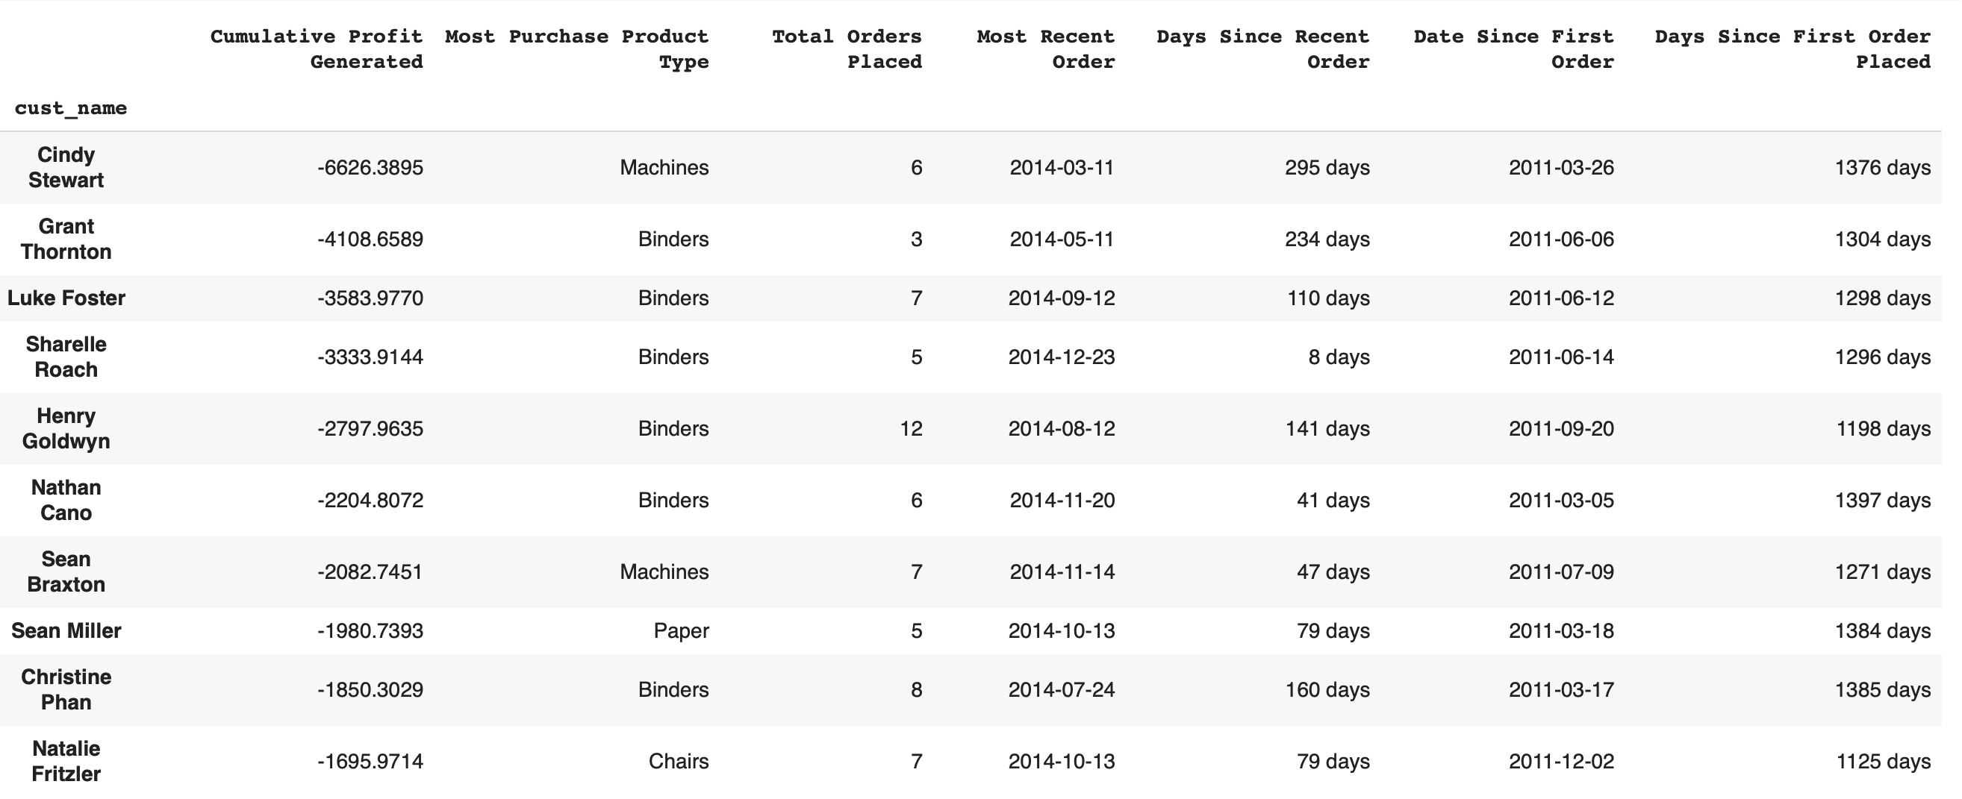
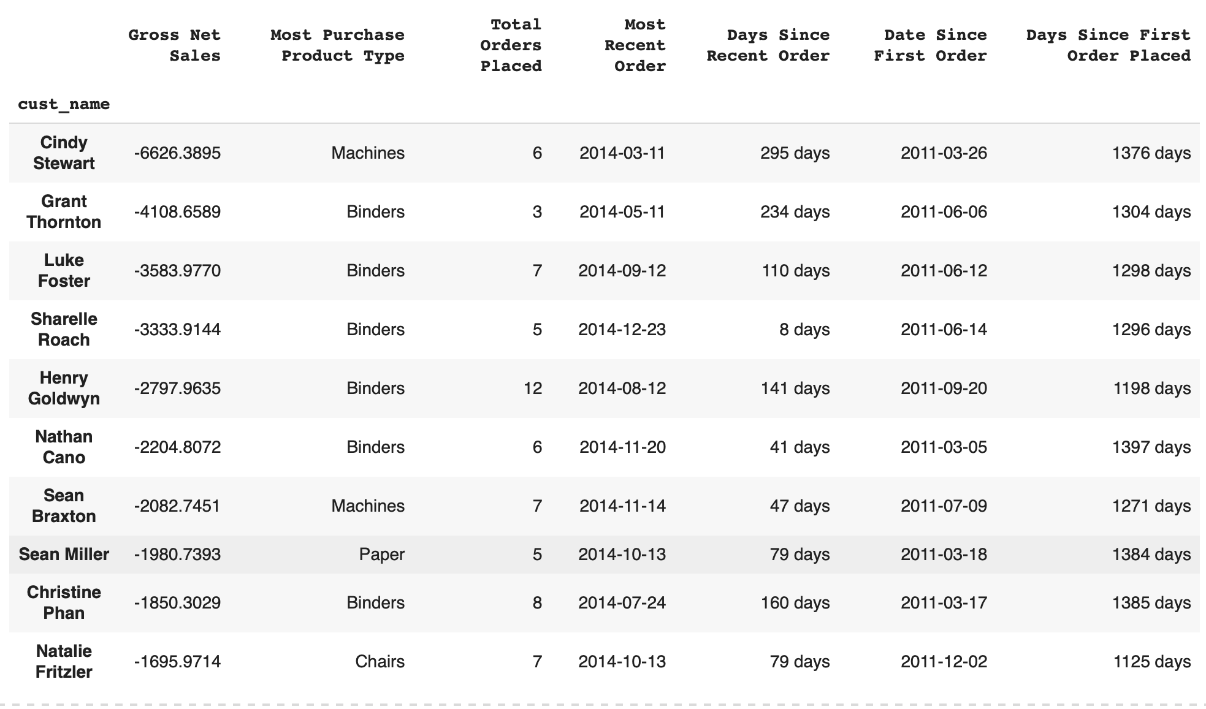
Least Profitable Clients (2011-2014)
Least Profitable Clients
It’s worth considering, should these customers really be avoided?
Professional Consultive Advice
Identifying customers as “least profitable” is premature until supply chain issues have been resolved. These negative net sales are due to SS’s irresponsible past sales decisions.

Slide 39
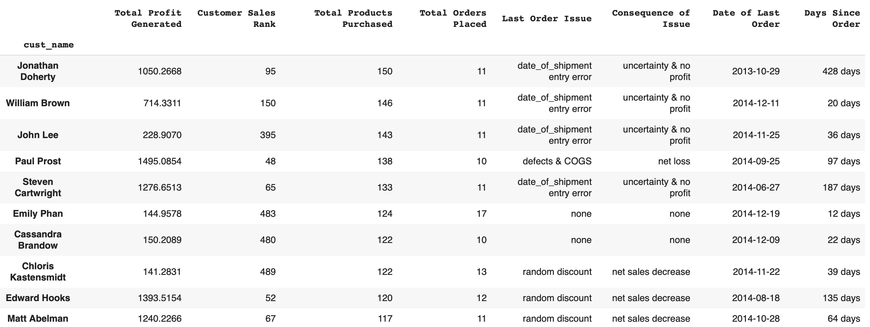
Most Products by Client (2011-2014)
Noteworthy Insight
Even considering the extravagant amount of discounts that have (most likely) been applied to these customers, it is clear that there is a relationship between customers ordering more products and those customers generating profitable sales for SS.
Customers ordering more products should be the clients that SS focuses on marketing to and treated as “most profitable”.
Recommended Strategy
Consider reaching out to these customers via email, with a survey, querying what they would like SS to enhance in the business model going forward. These customers will feel valued and will increase the probability they will continue choosing SS for their product needs.
- e.g., An easier to navigate electronic catalog? Increased inventory of some product?
Notes:
Duplicated slide

Slide 40
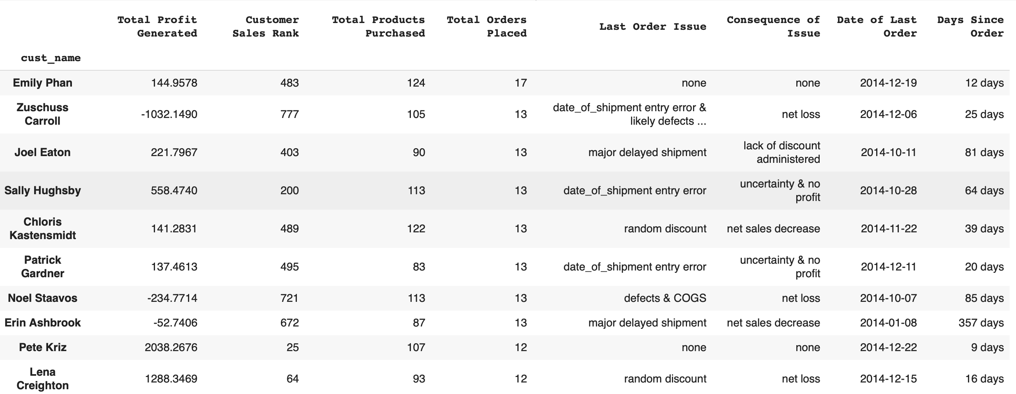
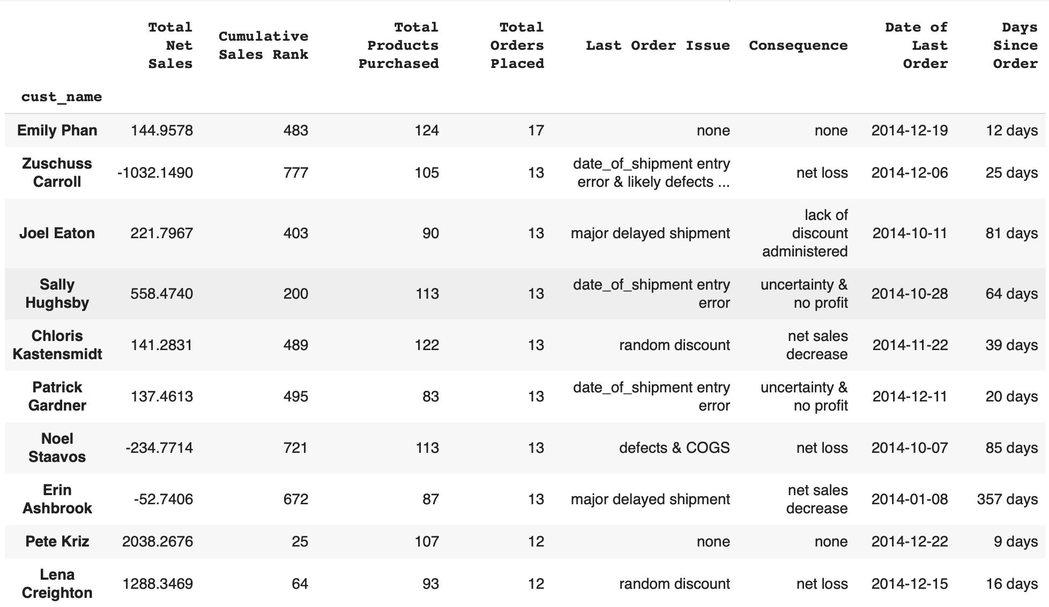
Most Orders by Client (2011-2014)
Cumulative Graph Outlining The Most Individual Orders Placed By Customers Since Sales Have Been Recognized
Although these customers “bottom line” in terms of profit generated, may not look promising at first glance, my advice is to aim towards strengthening relationships with these customers going forward. They have all made purchases relatively recently and once the issues on the backend of sales are resolved they will likely be eager to place more frequent orders.

Slide 41
2 Additional Sale Issues & Outcomes

Slide 42
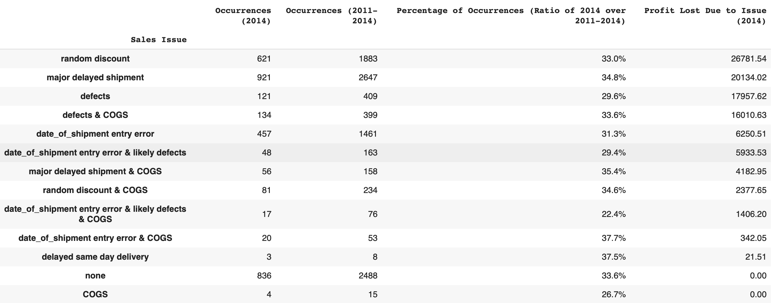
‘Sale Issue’ Dictionary
Random Discount: A discount that was applied to a sale for a reason that can’t be classified with the given data; thus, my impression is again that the previous VP in sales distributed these discounts to increase sales volume and customer retention would, without paying attention to profit margins of the goods being sold. These discounts have been the primary reason for loss in sales in 2014.
Major Delayed Shipment: Discounts very likely issued because the order took well over 10 days past the standard average for the shipping class the good was sold under.
Date of Shipment Entry Error: The order had a “date of shipment” recognized as being BEFORE the day ordered.
COGS: The cost of the good was equal to or greater than the price of the good sold. Note: The chart declares that orders marked with COGS resulted in no LOSS in sales, but all four of these issues in sales resulted in exactly no profit earned.

Slide 43
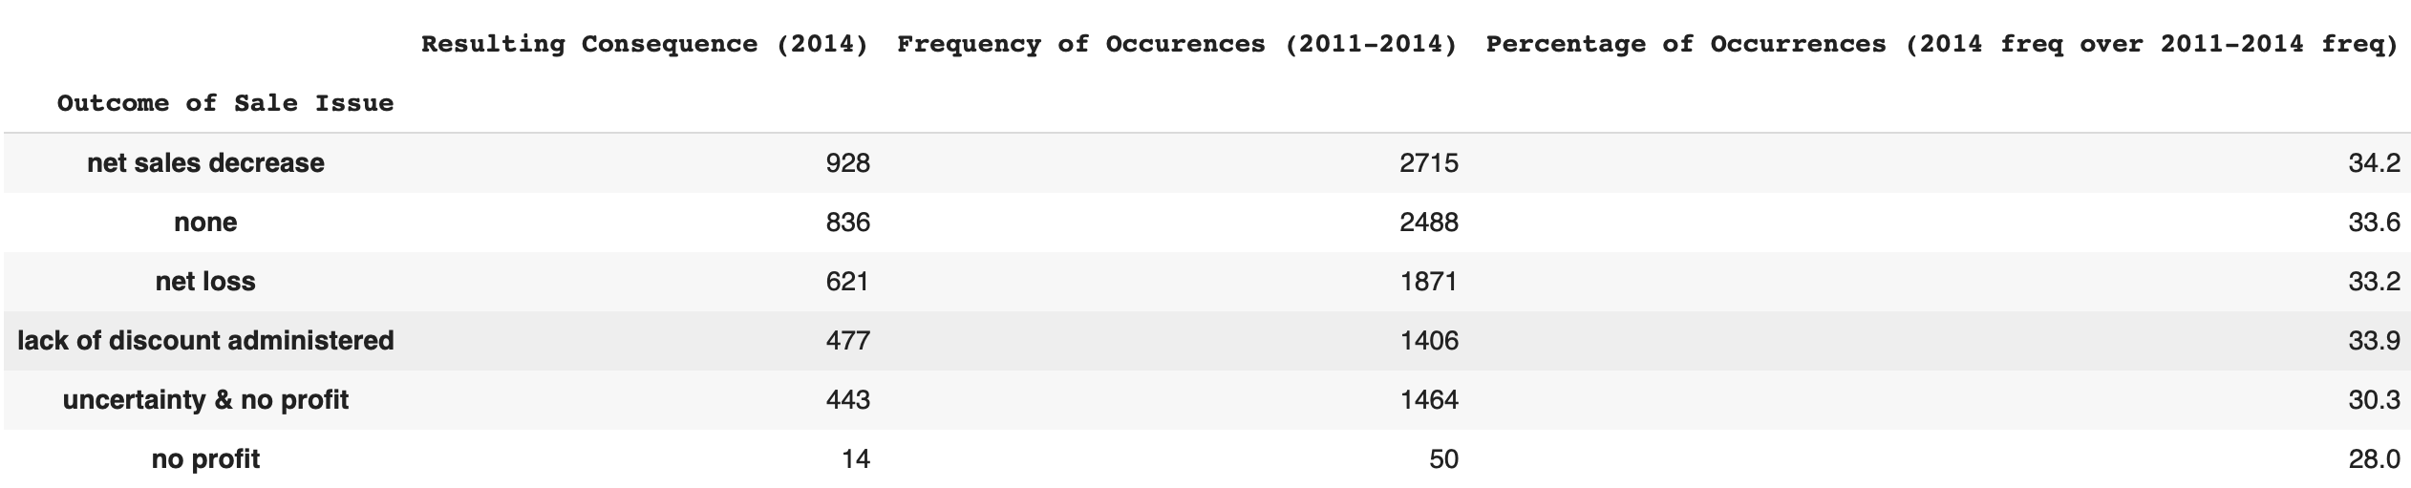
Outcomes of Sales Issues
Detail and Descriptions on “Outcomes” of Sale Issues
Initially, SS had a clientele base of 793 unique customers. As of 2014, this number has decreased to only 693customers.
As illustrated, a primary reason for this is likely due to extremely delayed shipping times; moreover, out of the 3319 recognized sales receipts in 2014 only roughly 25% of them could be confidently marked as having no sale issue.
Lack of Discount Administered: These customers experienced EXTREME shipping delays (10 days or more past the expected shipping time) and yet were given no sales discount. Another likely reason some customers have not returned to making purchases from SS.
Uncertainty & No Profit: These sales were recorded with shipping dates well before the actual order was placed, making the issue for the discount ultimately impossible to trace. A majority of these sales contained products being sold that cost more to sell than their respective sales revenues.
Notes:
Potential for main

Slide 44
Table of Contents: Model Appendix
Presentation Model
Why Shipment Issues?
Why Classification Tree?
Methodology Detail, Key Ratios, & Current Limitations
Envisioned Theoretical Model

Slide 45
1.1 Presentation Model: Why Prioritize Shipment Issues?

Slide 46

Why Prioritize Shipment Issues?
Reasoning
Outside of (Total) Shipment Issues, the next most frequent sales issue, random discount, cumulatively arose in conjunction with 21.15% of SS’ sales in 2014.
On aggregate, this amounts to less than half of the total percentage of Total Shipment Issue occurrences.
Every other recognized sales issue makes up a small ratio of SS’ total sales transactions.
Defects, can be resolved by enhancing customer relationships; moreover, these issues arose in only roughly 7% of sales.
Random discounts can be easily resolved by understanding that overzealous issuance of discounts to customer orders is not a good business strategy, especially considering profit margins.
Obtaining the data to understand ‘Shipment Issues’, by following the leads provided by the CART model, should naturally lead to understanding most of what is causing COGS issues to arise.

Slide 47
1.2 Presentation Model: Why Classification Tree?

Slide 48

Classification Model Selection
Why a Classification Tree was determined to be the appropriate Machine Learning algorithm to remedy the ‘Shipment Issue’ in sales
Scope of model is too complex for an alternative supervised learning algorithm, especially in the long haul.
More variables = increased likelihood that model will overfit and prove unreliable
To pinpoint and characterize exactly what is causing ‘Shipment Issues’ to occur, a binary classification model is undoubtedly optimal.
Most efficient model to implement with a Data Mart, without worry of overfitting causing model to lose usefulness.
Can be built upon and fine-tuned as needed, without much coding effort.
Easy to comprehend visually. Visual classification and splitting methodology
crucial for understanding the issue at a deeper level.
Predictive efficiency easily understood.

Slide 49
1.3 Presentation Model: Efficiency, Methodology Detail & Key Ratios

Slide 50
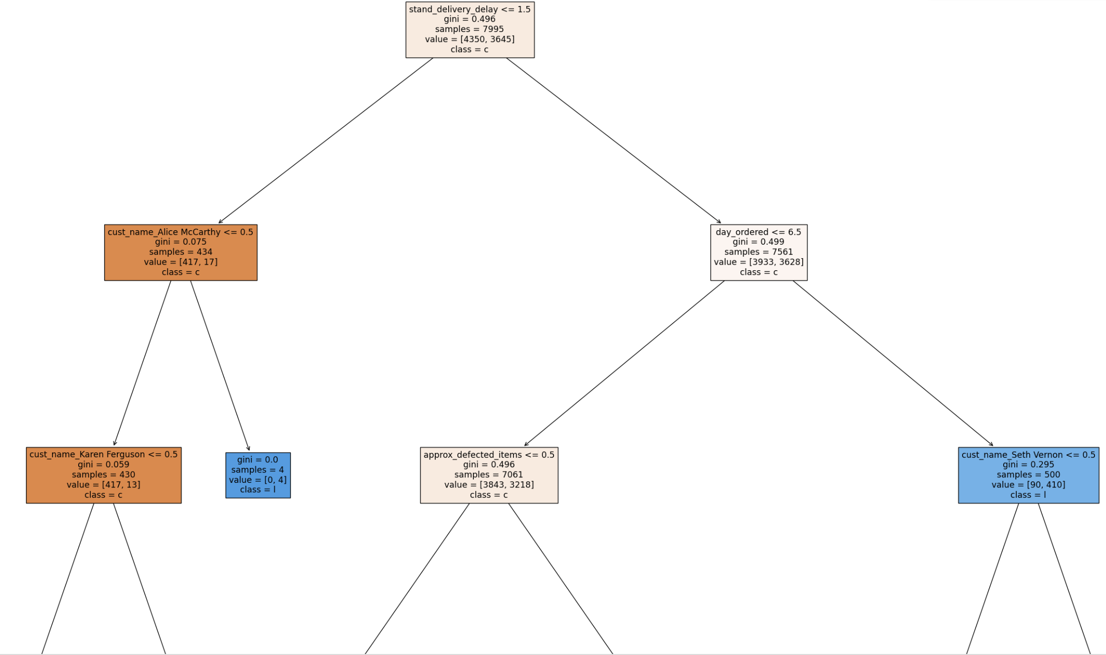
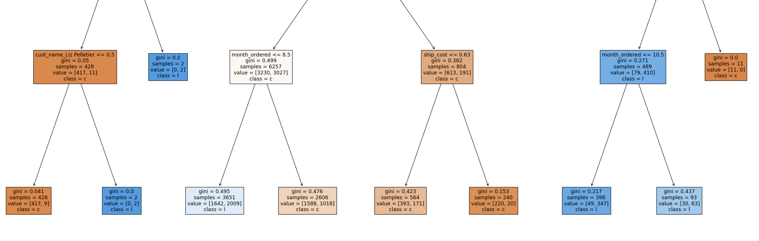
The Model: Classification Tree
Detail on Design & Efficiency
Model trained on, cumulatively, 7995 transactions.
4350 with no issue in shipment
3645 with issue in shipment
80% of data used to train model -> accurately predicted 63.23% of the training data.
During testing, model was able to predict appropriately for 63.28% of the data.
Predictive capabilities improve, definitively, as it learns
More transactions -> more accuracy
It’s important to remember that a large portion of the ‘no issue in shipment’ observations had other issues in sales. The fact the model is able to discern & predict a good deal above random guessing, whilst differentiating these other sales issues and being trained with limited data, is applaudable and supports its usefulness going forward.
Notes:
Left off here

Slide 51
Analysis of Splitting Methodology
Some Insights Regarding Models Classification Methodology
Model appears very confident in its classification of certain customers who ordered using ‘Same Day’ either having or not having experienced an issue with shipment. E.g., Model classifies a customer named Alice McCarthy, who ordered with Same Day Delivery, as having had 4 orders containing shipping issues.
Additionally, model is mostly confident that orders placed on Friday, during the months of January -October, experience a higher-than- normal issue rate with shipment.
This information gives strong indication that other Customers ordering with similar customer demographics and characteristics are experiencing similar problems.
The distribution and production centers should be made aware of this issue.
This information provides an avenue to pursue in negating this issue from future orders.

Slide 52
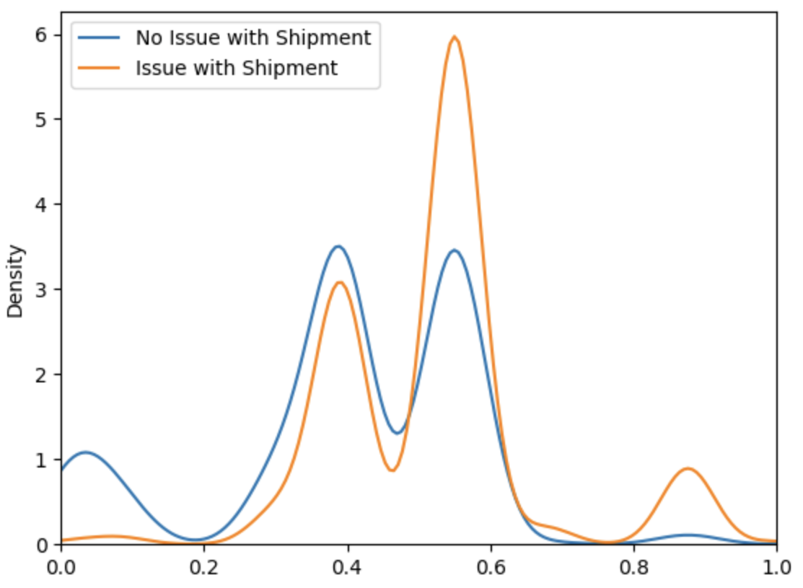
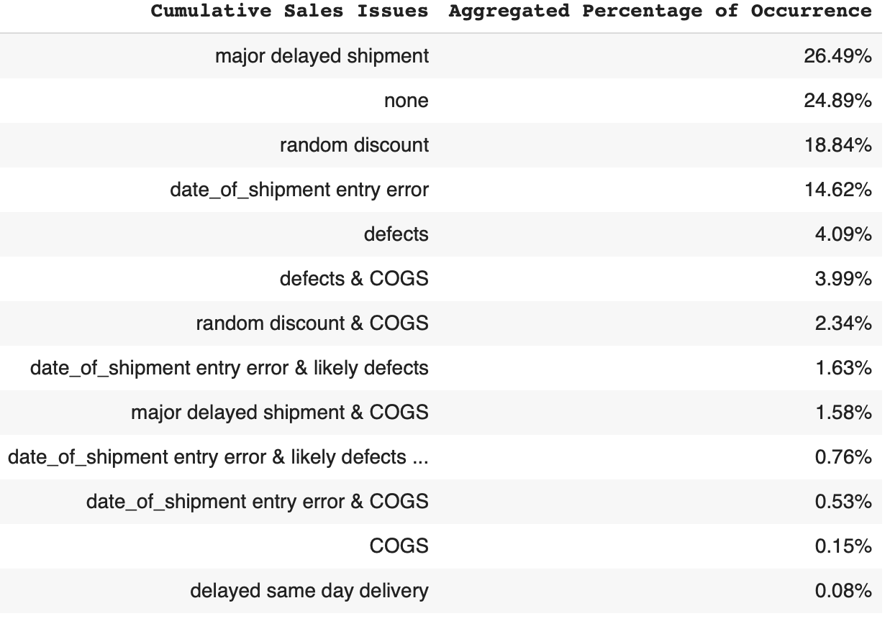

KDE Plot with Given Limited Data
Visual of Models Current Confidence in Classifying Sales (Predictions)
Model slightly more confident in inferring Issues with Shipment
Ideally, plot does not display overlap when classifying.
Unless provided higher quality data to describe each record, models predictive confidence is not optimal
Reasons for Overlap
Once certain sales issues are circumvented (e.g., random discounts, COGS) and/or
appropriate data is captured to fully detail an orders logistic information,
this model will be able to foreshadow which orders are most likely to cause shipment issues without issue .

Slide 53
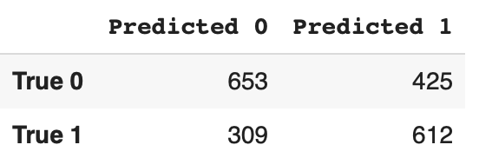
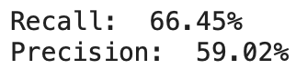
Key Ratios
Analysis of Confusion Matrix on Testing Performance
653 True Negatives: The model correctly predicted that the transaction didn’t have an issue with shipment.
612 True Positives: The model correctly predicted these transactions did have issues with shipment.
425 False Positives: The model incorrectly labeled these transactions as having issues with shipment, when they in fact, did not.
309 False Negatives: The model incorrectly labeled these transactions as not having issues with shipment, when they in fact did.
It is promising that a False Negative occurred with the least frequency because this carries the greatest weight in purpose of model!
Analysis of Recall & Precision
Recall: Model was able to successfully predict 66.45 percent of all the transactions that were defined as having had an ‘Issues with Shipment’, during testing.
Precision: Metric detailing how accurate model was in its prediction of a transaction being labeled as having had an ‘Issues with Shipment’, when model labeled transaction as having an ‘Issue with Shipment’.

Slide 54
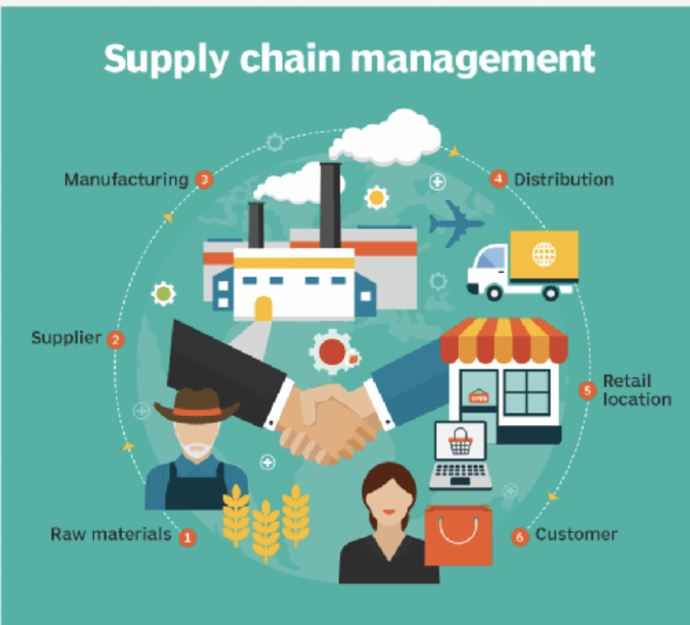


Model Limitations
Model’s current predictive capabilities and confidence in discerning ‘Shipment Issues’ is moderate.
Model must make use of all transaction history to provide only a reasonable level of predictability.
Some of these transactions may not be relevant to SS’ present business environment.
Model not provided enough quality data: data that efficiently provides model with supply chain-related attributes, to classify supply chain-related issues. This data needs to be obtained and that may take some time.
For optimum value, SS will likely have to interconnect the model with a data mart to properly train the model and build upon its current state.

Slide 55
2 Potential Model (illustrates Presentation Model’s potential, given additional data inputs)

Slide 56
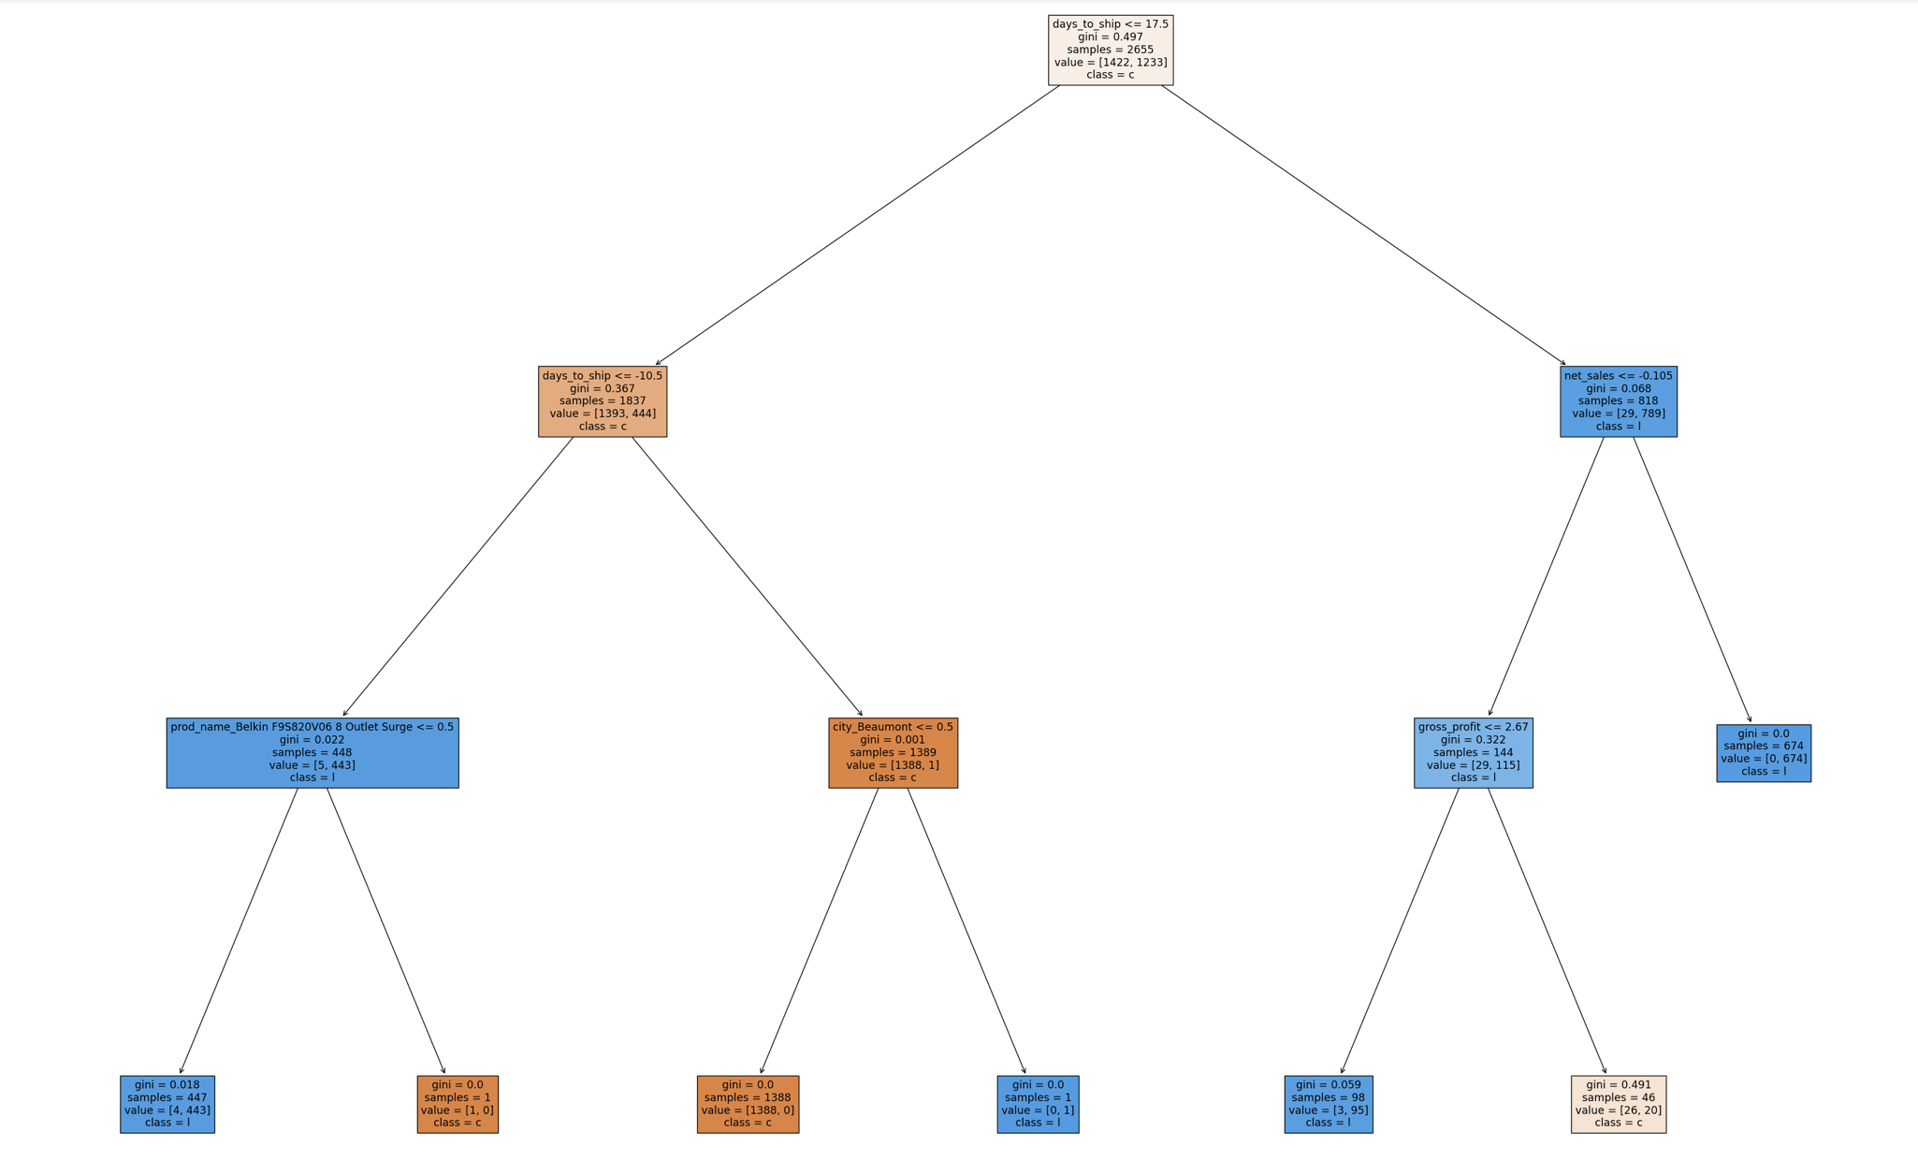
The Model: Classification Tree

Slide 57
Holistic Description of Model
Classification Tree to Predict Probability that a Sale will lead to a Shipment Issue
Objective: To illustrate “primary model’s” potential, as more ‘Shipment data’ is attributed to each transaction.
Data Used in Training & Testing: Each transaction that occurred in the most recent sales period strictly (2014). Includes days took to ship for each transaction.
Binary Classification: Each observation was labeled with either a 0 (No Shipment Issue) or a 1 (Shipment Issue) for training. These output values were hidden from the model during testing.
Limiting Complexity of Model & Preventing Overfitting:
Manual Dimensionality Reduction of variables likely to be recognized as noise (e.g., Order #)
Model Depth capped at 3. Minimum sample size to split at 20.

Slide 58
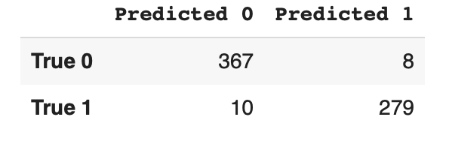
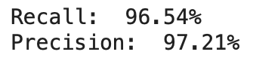
Key Ratios: Less input, higher quality variables
Analysis of Confusion Matrix on Testing Performance
367 True Negatives: The model correctly predicted that the transaction didn’t have an issue with shipment.
279 True Positives: The model correctly predicted these transactions did have issues with shipment.
8 False Positives: The model incorrectly labeled these transactions as having issues with shipment, when they in fact, did not.
10 False Negatives: The model incorrectly labeled these transactions as not having issues with shipment, when they in fact did.
Analysis of Recall & Precision
Recall: Model was able to successfully predict 96.54 percent of all the transactions that were defined as having had an ‘Issues with Shipment’, during testing.
Precision: Measures how accurate model was in its prediction of a transaction being labeled as having had an ‘Issues with Shipment’, when model label transaction as having an ‘Issue with Shipment’.

Slide 59

Free templates for all your presentation needs
For PowerPoint and Google Slides
100% free for personal or commercial use
Ready to use, professional and customizable
Blow your audience away with attractive visuals

